Slide 1
NPL MARKET AND CREDIT GROWTH
Vladimir Vasic
ASB Secretary General
Tirana, 14.05.2019

Slide 2
Agenda
Macroeconomic developments in Serbia
Banking sector of Serbia in 2018
Efforts on NPL Resolution (NPL Strategy/2015-2018)
Next steps (NPL Program/2018-2020)

Slide 3
Macroeconomic developments in Serbia

Slide 4
Sustained Macroeconomic Stability
In six years, Serbia has transformed to a low inflation and stable growing economy, with:
Fiscal surplus (0.6% of GDP)
Declining public debt (in the beginning of 2019 - 50.4% of GDP)
Monetary stability:
Stable and low inflation (average level of 2.0% in 2018)
Stable FX rate (The dinar remained stable against the euro in 2018)
Source: NBS, www.nbs.rs

Slide 5
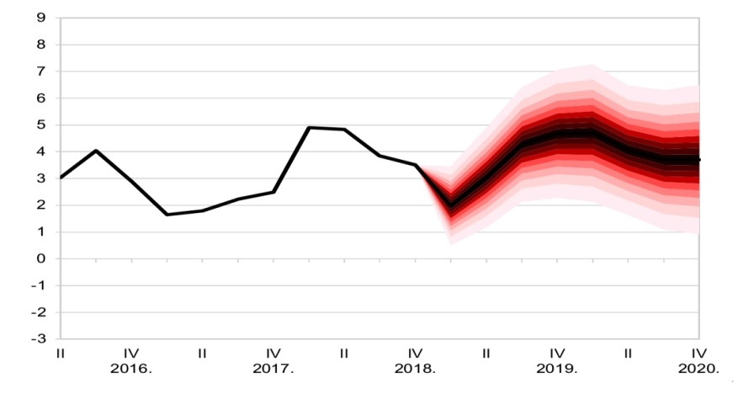
GDP growth
GDP growth in 2018 picked up to over 4% on the back of robust investment activity, exports and labour market recovery
Pre-crisis GDP growth was driven by consumption, the trend reversed after the crisis in favour of investments and exports
In 2019 we expect GDP growth of 3.5%, while in the medium run, we expect it to accelerate to around 4%
GDP growth projection (from February 2019 IR)
(y/y rates, in %)
Source: NBS, www.nbs.rs

Slide 6
The New Investment Cycle
In the past four years, fixed investments grew at an avg. rate of around 7%, with cumulative growth of around 30%
In 2018 investment growth picked up to 9.2% providing a key contribution to higher-than-expected GDP growth. The growth was led by both public and private investment
Source: NBS, www.nbs.rs

Slide 7
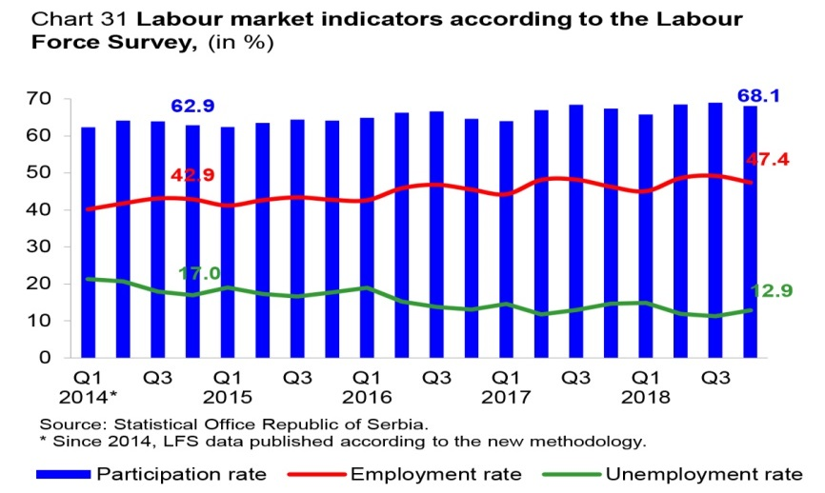
Sustainable Recovery of the Labour Market
The unemployment rate declined both in Q4 2018 and for the whole year
According to the Labour Force Survey, the unemployment rate in Q4 2018 was 12.9% (decline for 1.8 pp. y/y), and employment rate 47.4% (y/y growth by 1.1 pp). The participation rate was higher by 0.7 pp and was 68.1%
Favourable trends in the formal labour market come from the private sector, where employment increased by 13.9% (February 2019/December 2014) - mainly in manufacturing, private sector services and construction
Source: NBS, www.nbs.rs

Slide 8
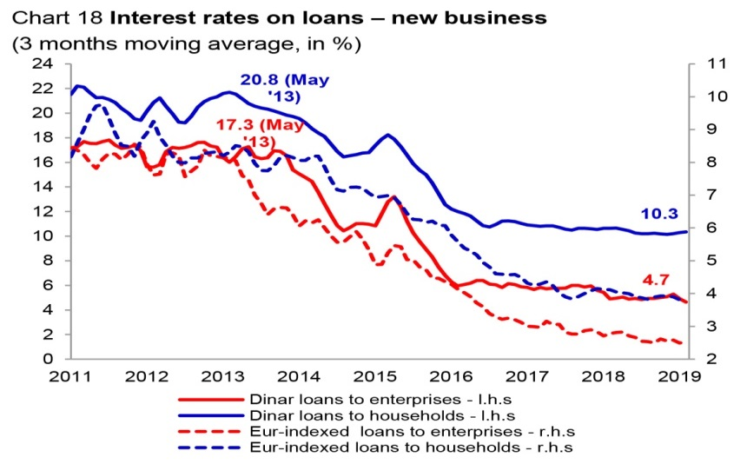
Key policy rate and Interest rate on din/eur loans
The policy rate was cut in March and April 2018, both times by 25bp, to its current level of 3.0%
Interest rates on dinar loans have declined significantly over the last six years
Since the beginning of the monetary policy relaxation cycle (May 2013), dinar lending interest rates fell sharply. In February 2019, the dinar interest rate for thecorporate sector stood at 4.3% (down by 12.1 pp), and for households at 10.3% (down by 10.3 pp)
In parallel to new business, interest rates on outstanding loans also fell sharply, leading to higher disposable income for consumption and investments, of both households and corporates
In the observed period, a sharp fall in the country risk premium and monetary easing by the ECB contributed to the fall in EUR-indexed lending rates
Source: NBS, www.nbs.rs

Slide 9
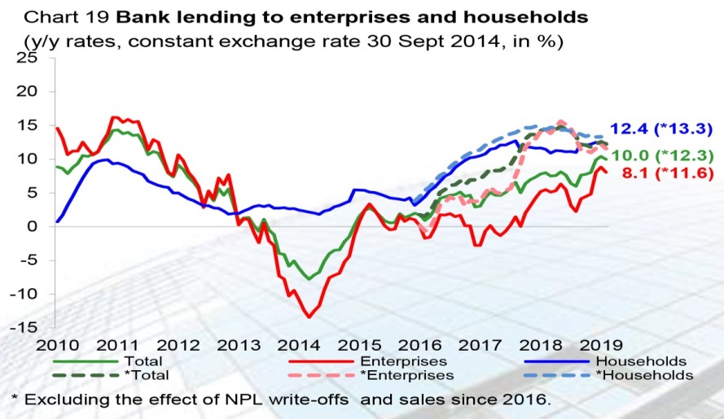
Lending activity
Led by demand and supply factors, lending activity recorded a 10.0% y/y growth rate in February 2019 (9.9% end-2018)
Excluding the effect of NPL write-offs and sales, total lending growth reached 12.3% y/y in February 2019 (+11.6% y/y to enterprises and +13.3% y/y to households)
Further growth of lending activity is expected in the coming period, as a result of sustainable economic growth, improved conditions in the labor market, effects of past monetary policy easing by the NBS, low interest rates in the euro area, interbank competition and reduced NPLs
Source: NBS, www.nbs.rs

Slide 10
Rating Outlook for Serbia Improved
Serbia’s risk premium remains among the lowest in the region, primarily as a result of domestic factors, such as multiyear narrowing in internal and external imbalances, and a favorable growth outlook
In December 2018 S&P improved outlook from ’stable’ to ’positive’ and affirmed rating at BB, on the back of accelerated economic growth and maintenance of price and financial stability

Slide 11
Banking sector of Serbia in 2018

Slide 12
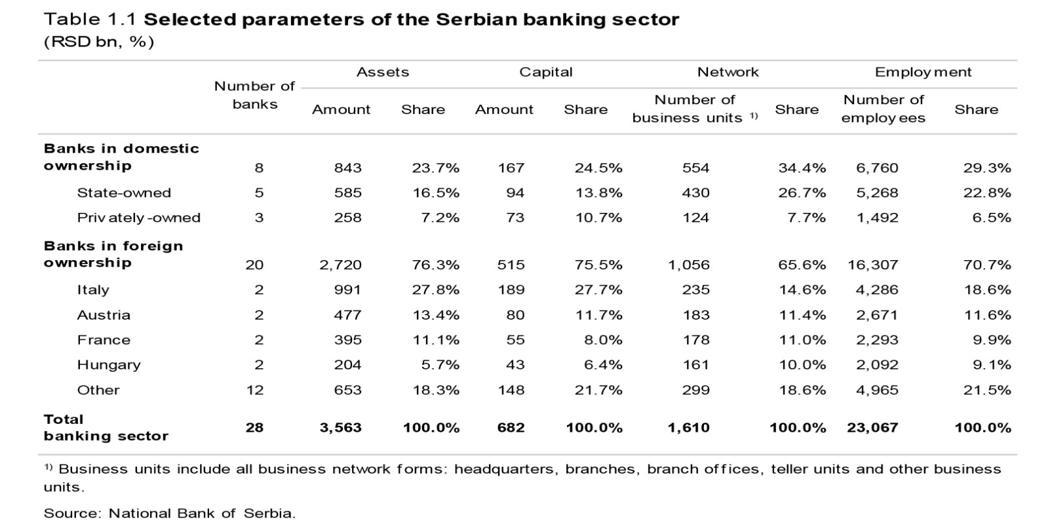
Selected parameters of the Serbian banking sector
Source: National Bank of Serbia, Q3

Slide 13
Banking sector - market share

Slide 14
Indicators of Assets Quality, Safety and Profitability
in %
 | 2014. | 2015. | 2016. | 2017. | 2018.
Standard NPLs ratio, % | 21,5 | 21,6 | 17,0 | 9,8 | 6,4 (IV5,7)
IFRS impairment of NPLs,% | 54,9 | 62,3 | 67,8 | 58,1 | 60,2
Pretax income,EURm | 29,0 | 80,0 | 172,0 | 579,8 | 640,6
Capital adequacy ratio,% | 20,0 | 20,9 | 21,8 | 22,6 | 22,3
Sector liquidity indicator,% | 2,2 | 2,1 | 2,1 | 2,0 | 2,0
ROA,% | 0,1 | 0,3 | 0,7 | 2,1 | 2,1
ROE,% | 0,6 | 1,6 | 3,4 | 10,6 | 10,6
Source: National Bank of Serbia, www.nbs.rs

Slide 15
Non-Performing Loans (NPLs) (Gross Accounting Value)
in / EUR million
Item | Curr. | 2015. | 2016. | 2017. | 2018.
Total loans | EUR | 16,175 | 16,442 | 17,565 | 19,406
NPLs | EUR | 3,491 | 2,800 | 1,730 | 1,105
% of share of NPLs in total loans |  | 21,6% | 17,0% | 9,8% | 5,7
Source: NBS

Slide 16
Banking sector stability
Encouraged by the NBS measures, the share of NPLs in total loans declined to 5.6% at February 2019, which is the lowest level since 2008 when this indicator of portfolio quality was introduced with the maintenance of relatively high coverage by IFRS provisions (60.4%)
Capital adequacy indicators are even stronger after the application of Basel III standards in Serbia
Liquidity ratios are constantly at levels significantly higher than the regulatory minimum
The preserved profitability of the banking sector at end 2018. resulted in the following profitability indicators ROA – 2,1% and ROE – 10,6%
Banking sector stability has been preserved and further reinforced

Slide 17
Efforts on NPL Resolution
(NPL Strategy/2015-2018)

Slide 18
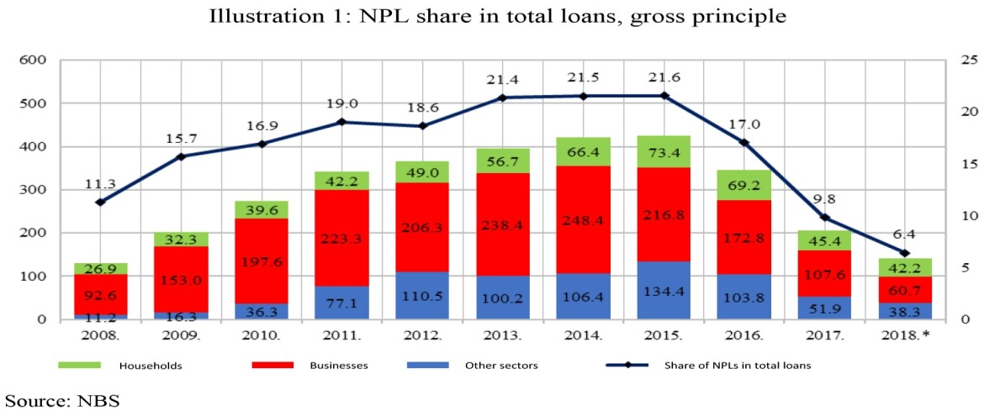
Movements and structure of NPLs
At the outset of the global financial downturn, Serbia’s NPL stock was already large compared to other countries (11.3% gross in late 2008) and had reached a historic high of 21,6 % at the time the Strategy was being developed in 2015.
On 13 August 2015, the Government adopted the national NPL Resolution Strategy.
In addition, both the Government and the National Bank of Serbia adopted action plans in order to fulfil strategic objectives

Slide 19
Standard NPL Ratio in the Region
 | 2015 | 2016 | 2017 | 2018
Serbia | 21.6 | 17.0 | 10.0 | 5,7
Croatia | 16.3 | 13.6 | 12.3 | 9.7
Bosnia and Herzegovina | 13.7 | 11.8 | 11.0 | 9.4
Slovenia | 9.9 | 5.0 | 3.2 | 1.9
Hungary | 11.6 | 13.6 | 12.3 | 2.5
Slovakia | 4.9 | 4.4 | 3.9 | 3.1
Romania | 13.5 | 9.6 | 7.9 | 5.6
Albania | 18.2 | 18.3 | 13.2 | 11.0
Source: GFSR Tables, Q4 2018 NBS

Slide 20
Implemented activities during the Strategy application
In the three-year period of the Strategy application, a great number of legal acts and bylaws were adopted and amended, the institutional capacity was improved and many measures for easier write-off and transfer of uncollectable claims were implemented:
The adoption of the Law on Appraisers of Real Estate Values
Law on the amendments to the Tax Profit Law enable more favorable tax treatment for banks in case of claims write-off
Law on the amendments to the Law on Consensual Financial Restructuring of Companies - simplifies the legal framework for institutional extrajudicial restructuring of debts.
The adoption of the amendments to the Law on Enforcement and Security
The adoption of the amendments to the Law on Mortgage enable the buyer of the real estate which is collateral to realize an extrajudicial purchase
The amendments to the Law on Bankruptcy improve the bankruptcy regulatory framework with additional protection of secured creditors and increase of the performance and responsibility of bankruptcy administrators.

Slide 21
Action Plan - NBS
In the previous period, the NBS carried out all activities envisaged by its Action Plan aimed primarily at the enhancement of banks’ capacities to resolve NPLs. In line with this plan, the NBS:
Established a database on real estate collateral valuations and loans approved based on reported collateral and Introduced additional requests for banks regarding monitoring of collateral and engagement of persons that evaluate that collateral
Strengthened the regulatory treatment of restructured receivables in order to encourage sustainable restructuring practices and prevent the unsustainable refinancing practices (evergreening)
The distressed asset management in banks has been improved by introducing additional requirements for banks in the context of strategic planning
Published the Guidelines for implementation of IAS 39
Enhanced the reporting of NPLs by banks
Introducing the obligatory write-offs of NPLs which are fully impaired
Regulatory treatment of particular undesirable transactions related to NPLs

Slide 22
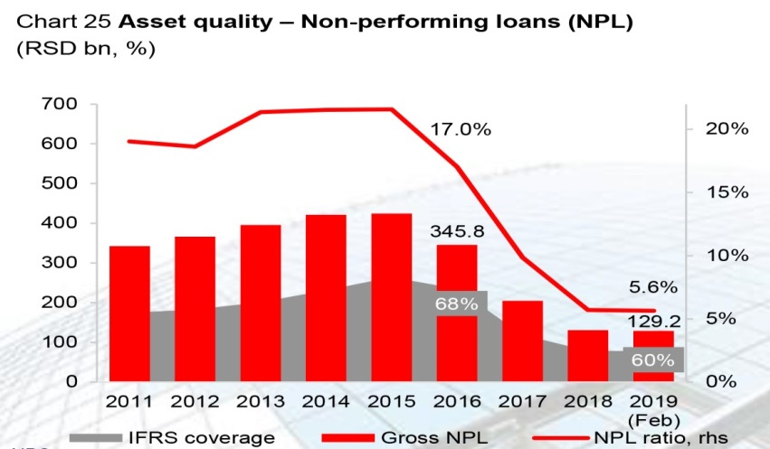
Improving the quality of the banking sector assets
Implementation of NPLs resolution measures together with the growth of credit activity led to a significant improvement of the banks’ portfolio quality.
The share of NPLs decreased to the lowest level since the 2008 when the definition and reporting requirements were introduced.
At end-February 2019, the NPL ratio was 5.6%, with the maintenance of relatively high coverage by both, IFRS provisions (60.4%) and regulatory reserves (162.3%).
Source: NBS, www.nbs.rs

Slide 23
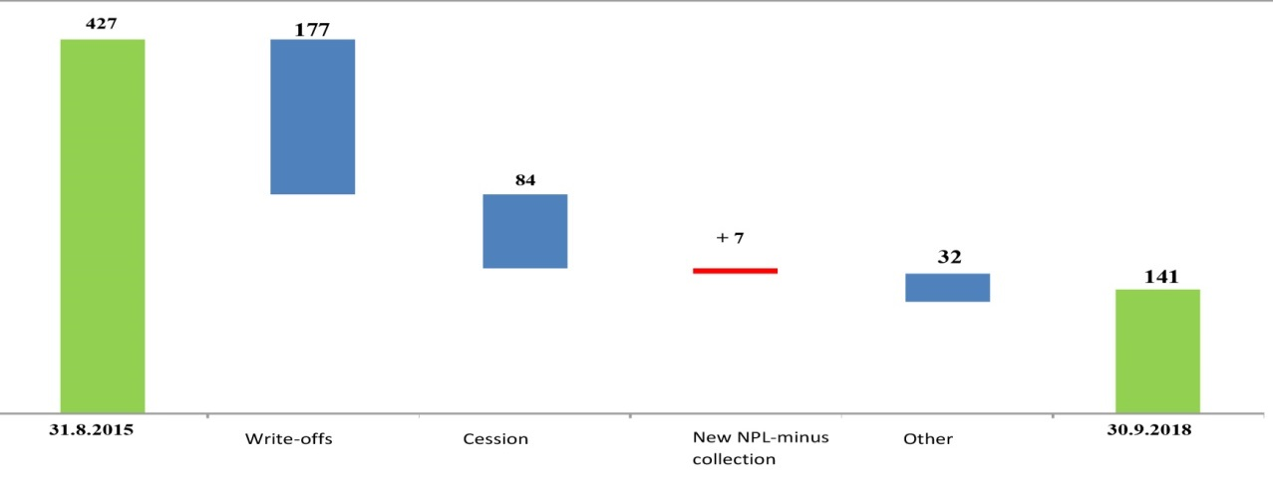
The main channels for the NPLs reduction
Several factors contributed to significant decrease of the level of NPLs in the previous three-year period:
write-offs of claims,
cession or sale of claims,
repayment and settlement and,
to a lesser extent, restructuring of claims.
Structure of the reduction of NPLs in EUR mil.
3,629
1,500
717
60
272
1,198
Source: NBS, www.nbs.rs

Slide 24
Receivables write-offs
Although the NBS Action Plan was accomplished, the NBS undertakes additional regulatory steps aiming to encourage the banks to resolve NPLs more efficiently and to establish a system that will prevent the accumulation of NPLs - Introducing the obligatory write-offs of NPLs which are fully impaired
Owing to the amendments of the legal regulation which provides more favorable tax treatment of the write-off (loan write-off is recognized as expenditure under certain circumstances) and primarily by the application of the Decision on accounting write-off of balance assets, the amount of written-off NPLs in the observed period amounted to 1,5 billion EUR

Slide 25
Cession or sale of claims
Cession (sale of claims). The increase of the number and volume of transactions at the market of NPLs is noticeable. In the observed period net amount of claims of banks sold to parties outside banking sector reached 717 million EUR
Collection of claims. In the observed three-year period the total amount of collected claims was 2.042 million EUR. In the same period the increase on the basis of new NPLs in the amount of 2.102 million EUR. Net NPL – 60 million EUR
Economic recovery. The share of NPLs has the fastest decrease in sectors with the biggest growth of activities (construction engineering, agriculture, industry, trade). This decrease was the most prominent in construction engineering

Slide 26
Total amount of sold claims
An important indicator of success of the Strategy in the segment of the development of the market of NPLs in Serbia is also the total amount of sold claims, balance and off-balance, to parties outside and in the banking sector, which amounted to 1.651 million EUR in the observed three-year period. Out of this amount, 81 percent of claims were sold to persons outside banking sector (1.331 million EUR)

Slide 27
Next steps (NPL Program/2018-2020)

Slide 28
Key priorities and planned activities for the period 2018-2020
In order to attain the fundamental goal, several crucial fields were identified and within these it is necessary to improve (1) regulatory framework, (2) enhancing institutional capacity (3) implementation of regulations:
Resolution of NPLs of banks in bankruptcy as well as claims in the name and for the account of the state
Improvement of the bankruptcy framework
Activities aimed at prevention of NPLs

Slide 29
Resolution of NPLs of banks in bankruptcy as well as claims in the name and for the account of the state
Sale of the pilot portfolio (the Deposit Insurance Agency launched its first public notice for the sale of a NPL portfolio worth 240 million euro)
Sale of the large portfolio
Solving of the remaining portfolio of state creditors

Slide 30
Improvement of the bankruptcy framework
Establishement of the internet portal for online auctions of bankruptcy assets
Improvement of the profession of bankruptcy administrators through trainings
Improvement of the operation of bankruptsy courts
Regulation of the bankruptcy of entrepreneurs

Slide 31
Activities aimed at the prevention of new NPLs
Development of study on corporate indebtedness and prevention of NPLs in the real sector
Development of tools for the purpose of prevention of financial distress and an outreach campaign
Improvement of the legal framework of the Law on Deadlines for Obligation Settlement in Commercial Transactions
Enhancement of legal framework governing real estate valuation

Slide 32
Thank you for your attention!

