Slide 1
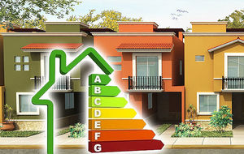
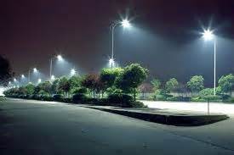

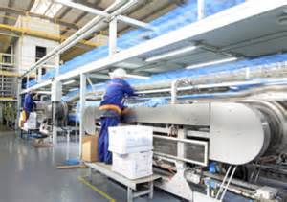
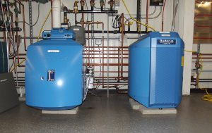
Mobilising private capital to support sustainable finance - how the EIB Group finances a sustainable future
Ines Hobdari - Senior Banker, EIB

Slide 2
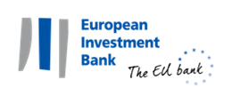
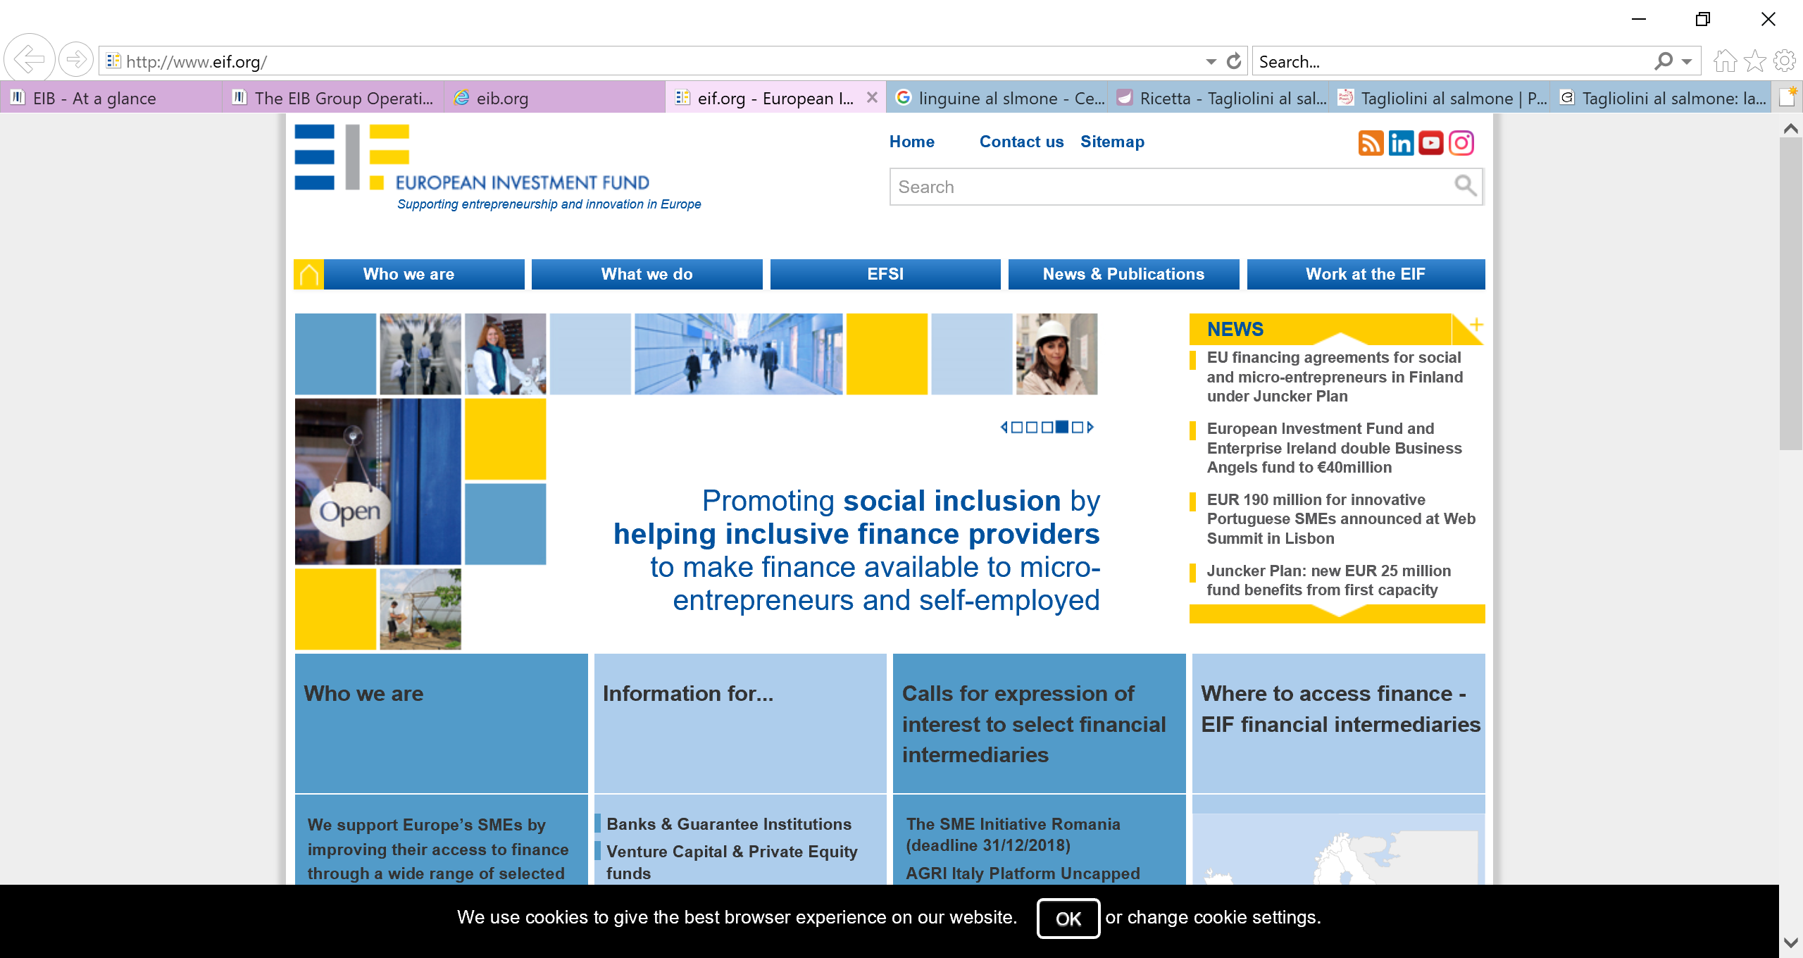
The EIB Group: the EIB and the EIF
The European Union's bank
  Founded in 1958
  Shareholders: 28 EU Member States
  Operates in the 28 EU Member States and more than 140 other countries
Largest multilateral lender and borrower in the world
  Raises funds on the international capital markets (AAA rating)
  60 years of experience in financing projects
Some 450 projects each year in over 160 countries
Headquartered in Luxembourg, over 40 local offices and over 3,000 staff
Present in the Western Balkans since 1977
Specialist provider of risk finance to benefit SMEs
Focus on Europe
Two statutory objectives:
  Foster EU objectives in the field of: entrepreneurship, growth, R&D, innovation, employment and regional development
  Generate an appropriate return for shareholders
Notes:
Headquarters in Lux, rep offices all around. 300 engineers and economists screens every project, before, during and after we lend
SMEs:
SMEs and mid-caps
Small and medium-sized enterprises (SMEs) are important drivers of growth, innovation and employment in Europe. SMEs represent 99% of businesses in the EU and employ two thirds of the active working population. Supporting access to finance for SMEs and mid-caps is a top priority for the EIB Group. EIB’s activity towards SMEs and mid-caps is typically more focused on delivering financial support (mainly funded) to established enterprises, mostly in the growth or maturity stages. The EIF typically concentrates on supporting enterprises in earlier stages of growth and the provision of guarantee schemes.
Our impact in 2017: In 2017 alone, the EIB Group financed SMEs and mid-caps across the globe to the tune of a record EUR 29.6 billion (EIB Group). We supported 285 800 smaller companies, which employ 3.9 million people.
Through our intermediaries, the EIB provides financing to:
micro-enterprises (0-9 employees)
small enterprises (10-49 employees)
medium-sized enterprises (50-249 employees*)
mid-caps (250-3 000 employees*)
Innovation and skills:
Innovation and skills are key ingredients for ensuring sustainable growth and creating high-value jobs. They play an important part in driving long-term competitiveness. For the EIB, this is a top priority. We are a major partner for projects that develop innovation and skills for a growing economy.
In 2017, we supported innovation and skills with EUR 13.8bn of EIB loans. Among other things, that enabled 7.4 million very high speed digital connections. In addition, we helped to install 36.8 million smart meters.
Infrastructure:
Infrastructure is an essential pillar that interconnects internal markets and economies. These projects play an important role in economic growth, sustainability and job creation, as well as ensuring competitiveness.
New investment in infrastructure requires substantial financing at reasonable costs. As the EU bank, we have made it a top priority to ensure that we continue supporting these initiatives, investing in energy efficiency, transport, water and sustainable urban infrastructure. Our projects are ambitious and vital to maintain economic growth in Europe and beyond.
In 2017, the EIB provided EUR 18 billion to support infrastructure projects. We powered 10.4 million households and helped to construct or upgrade 76 500 km of power lines.
Environment:
We back projects that protect the environment our children will live in while we innovate to make their future more prosperous. In line with our responsible approach to investment, environmental concerns are reflected in all our projects.
In 2017, the EU bank financed EUR 16.7 billion in projects for our natural and human environment, which includes biodiversity, clear air, clean water, sustainable transport, renewable energy and energy efficiency.
Climate Action:
Climate change is one of the greatest global challenges of our time. Immediate and coordinated action is crucial to overcome its effects. As the EU bank, we have made climate action one of our top priorities and today we are the largest multilateral provider of climate finance worldwide.
We commit to climate change adaptation and mitigation more than 25% of our total financing. For investments in developing countries, this figure will rise to 35% by 2020.
We are providing USD 100bn of climate-related projects in the five years from 2016 to 2020, as we help turn the COP21 ambitious Paris agreement into reality.
EIF:
We support Europe’s SMEs by improving their access to finance through a wide range of selected financial intermediaries. To this end, we design, promote and implement equity and debt financial instruments which specifically target SMEs. In this role, we foster EU objectives in support of entrepreneurship, growth, innovation, research and development, and employment.
We are a specialist provider of risk finance to benefit small and medium-sized enterprises (SME) across Europe. We are part of the EIB Group. Our shareholders are the European Investment Bank (EIB), the European Union, represented by the European Commission, and a wide range of public and private banks and financial institutions.
We carry out our activities using either our own resources or those provided by the European Investment Bank, the European Commission, by EU Member States or other third parties.
By developing and offering targeted financial products to our intermediaries, such as banks, guarantee and leasing companies, micro-credit providers and private equity funds, we enhance SMEs access to finance.
Our objectives
By taking SME risk, we pursue our two main statutory objectives:
fostering EU objectives, notably in the field of entrepreneurship, growth, innovation, research and development, employment and regional development;
generating an appropriate return for our shareholders, through a commercial pricing policy and a balance of fee and risk based income.
Our impact
More than 1 million SMEs have benefited from enhanced access to finance through financial instruments managed by EIF. On www.eif4smes.com you will find an interactive map that identifies all the SMEs that have received EU-support from EIF.

Slide 3


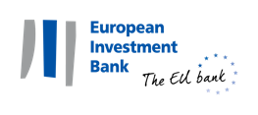

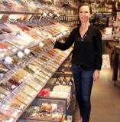

Supporting our
priorities….
…. with investments that matter
Innovation
EUR 13.5bn
Infrastructure
EUR 12.3bn
SMEs
EUR 23.3bn
Environment
EUR 15.2bn
EIB
Innovation
Environment
  EU
EUR 75.4bn
Outside EU
EUR 22bn
Infrastructure
SMEs
Total EIB Group financing signed in 2018:
EUR 64.2bn
Supporting EUR 230bn of total investment
5/13/2019

Slide 4


What can the EIB do? – Financing Instruments
The EIB has an extensive range of instruments to finance public and private sectors at investment and sub-investment grades of risk to its disposal.
EIB lending instrument
For Investment Grade operations
EIB special activities
For Low and Sub Investment Grade operations
Other donors
Banks
Public Sector Financing
Project Finance
Direct Loans
Intermediated Loans
Project Finance with direct project risk
Equity through Funds
Risk Sharing/ Blending
Projects

Slide 5
EIB Products
We help catalyse investments through
LENDING | BLENDING | ADVISING
Loans but also: Guarantees (trade financing) Equity participation | Combining EIB finance with EU budget (WBIF) Higher risk projects for innovation (through EU InnovFin initiative) | Prepare, evaluate and support the implementation of projects (JASPERS) Support for public/private partnerships (EPEC)
Attracting FUNDING for long-term growth

Slide 6
What can the EIB do? – Innovative Products
In addition to the more traditional financing products, EIB offers a number of innovative climate finance products coupled with technical and financial advice to engage the private sector to achieve:
Flexibility
Expertise & Creativity
Catalytic Effect
Leverage Effect
Broader eligibility of expenditure and in the use of funds for equity, debt and guarantee investment
Encouraging private and public sector commitment of investment, project implementation and management experience
Encouraging private and public sector commitment of investment, project implementation and management experience
  Enhancing the investment market complements other initiatives and additional sources of funding (including institutional investors)
  Enhancing the investment market complements other initiatives and additional sources of funding (including private investors)
EIB expertise and rigorous due diligence help meet the highest standards

Slide 7
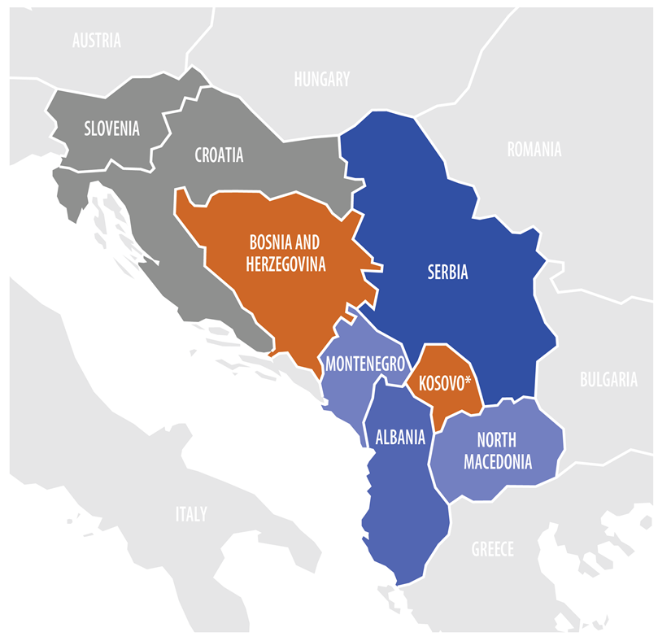






EIB in the Western Balkans
Supporting infrastructure, SMEs, innovation and climate action, in line with EU Accession Policy and the Berlin Process
Advisory/Technical Assistance
Strong cooperation with public authorities, local banking sector & partner International Financial Institutions (IFIs)
Combination of EIB funding and EU grants:
  Own resources;
  External Lending Mandate / Economic Resilience Initiative (ERI);
  Western Balkans Investment Framework (WBIF)
Country | EIB Signatures 2018 | EIB Signatures 2008 - 2018
Albania | EUR 105m | EUR 224m
Bosnia and Herzegovina | EUR 242m | EUR 1.65bn
Kosovo* | EUR 80m | EUR 219m
Montenegro | EUR 141m | EUR 719m
North Macedonia | EUR 100m | EUR 645m
Serbia | EUR 418m | EUR 4.19bn
TOTAL | EUR 1.09bn | EUR 7.65bn
*This designation is without prejudice to positions on status, and is in line with UNSCR 1244 and the ICJ Opinion on the Kosovo Independence Declaration

Slide 8

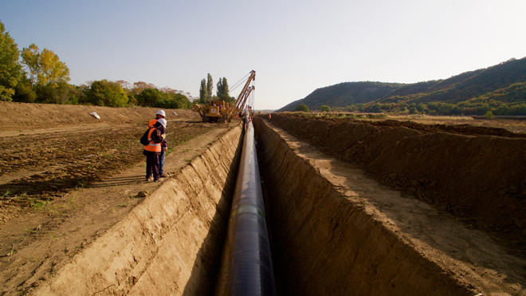
EIB in Albania
In 2018
EUR 105m signed
Active in Albania since 1995
EUR 224m of signatures between 2008-2018
We have helped build key infrastructure including EUR 18m for the construction of the Vlore motorway bypass and EUR 35m for the 22km motorway bypass around Fier which will improve travel, safety and environmental conditions
We are investing EUR 37.5m into the rehabilitation of primary and secondary roads to improve travel connectivity and support economic growth and social cohesion
    We are financing the Trans Adriatic Pipeline (TAP), which stems from the Greek/Turkish border to Italy through Albania.
    TAP will improve energy security and diversification sustaining the transition towards decarbonisation in Albania and wider Europe
    Up to 10bn m3
    of gas will be transported yearly

Slide 9
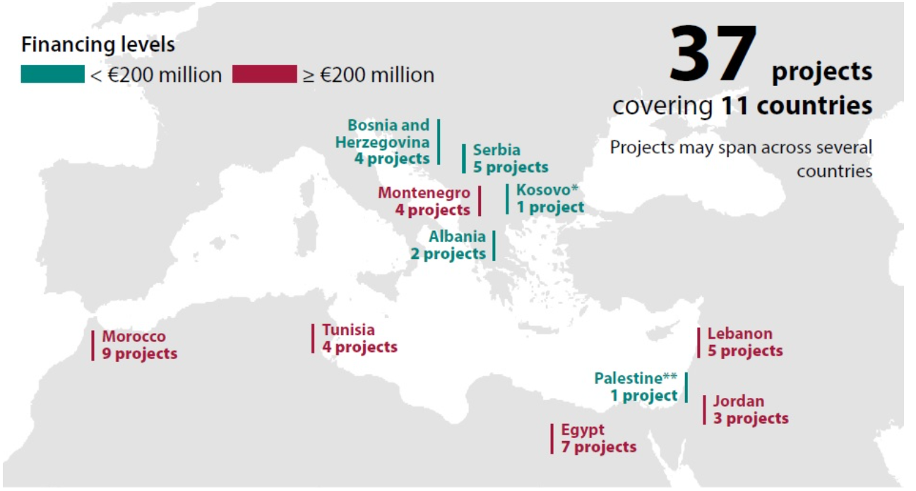
ERI - Economic Resilience Initiative

Slide 10
ERI and WBIF in the Western Balkans
Economic Resilience Initiative (ERI)
Western Balkans Investment Framework (WBIF)
Support growth, vital infrastructure and social cohesion in the Western Balkans and Southern Neighbourhood regions to help the most vulnerable populations
Loans and grants - creating job opportunities and generating resources for further public investment and services, pivotal for long-term economic resilience and stability
Clean water, energy and electricity, education, healthcare, local transport and urban services
Supports private sector growth
TA and advisory services to support the projects
A collaboration between EU and several IFIs, WBIF is a regional blending facility supporting EU accession and socio-economic development.
In 2018, WBIF provided financing and technical assistance to the private sector, as well as the energy, environment, social, transport, and digital infrastructure sectors.
2018 | WBIF (all IFIs) | WBIF (EIB as lead IFI)
Grants (IG & TA) | EUR 277m | EUR 97m (16 grants)
    EUR 2.8bn
    of signatures under ERI in the
    Western Balkans and Southern Neighbourhood (by end 2018)

Slide 11
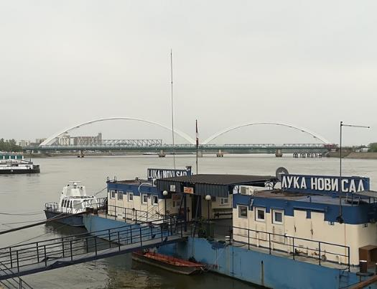

Flagship ERI projects in the Western Balkans
Serbian Inland Waterway Infrastructure
We provided EUR 100m to improve the safety and efficiency of water transportation along the Danube and Sava rivers in Serbia.
The project will improve services to the local and regional industries. It will also support growth and job creation, and enhance regional connectivity.
Cooperation with Raiffeisen in Bosnia and Herzegovina
We provided EUR 25m to Raiffeisen Leasing Bosnia and Herzegovina to finance SMEs and support projects in tourism, agriculture, healthcare, education, and the environment.
The operation will also focus on promoting youth employment under the European Youth Employment and Training for the Western Balkans (EYET) initiative. The loan will support c. 4,450 jobs (including existing and new jobs) and c. 445 SMEs.

Slide 12
EIB support to Sustainable Finance

Slide 13
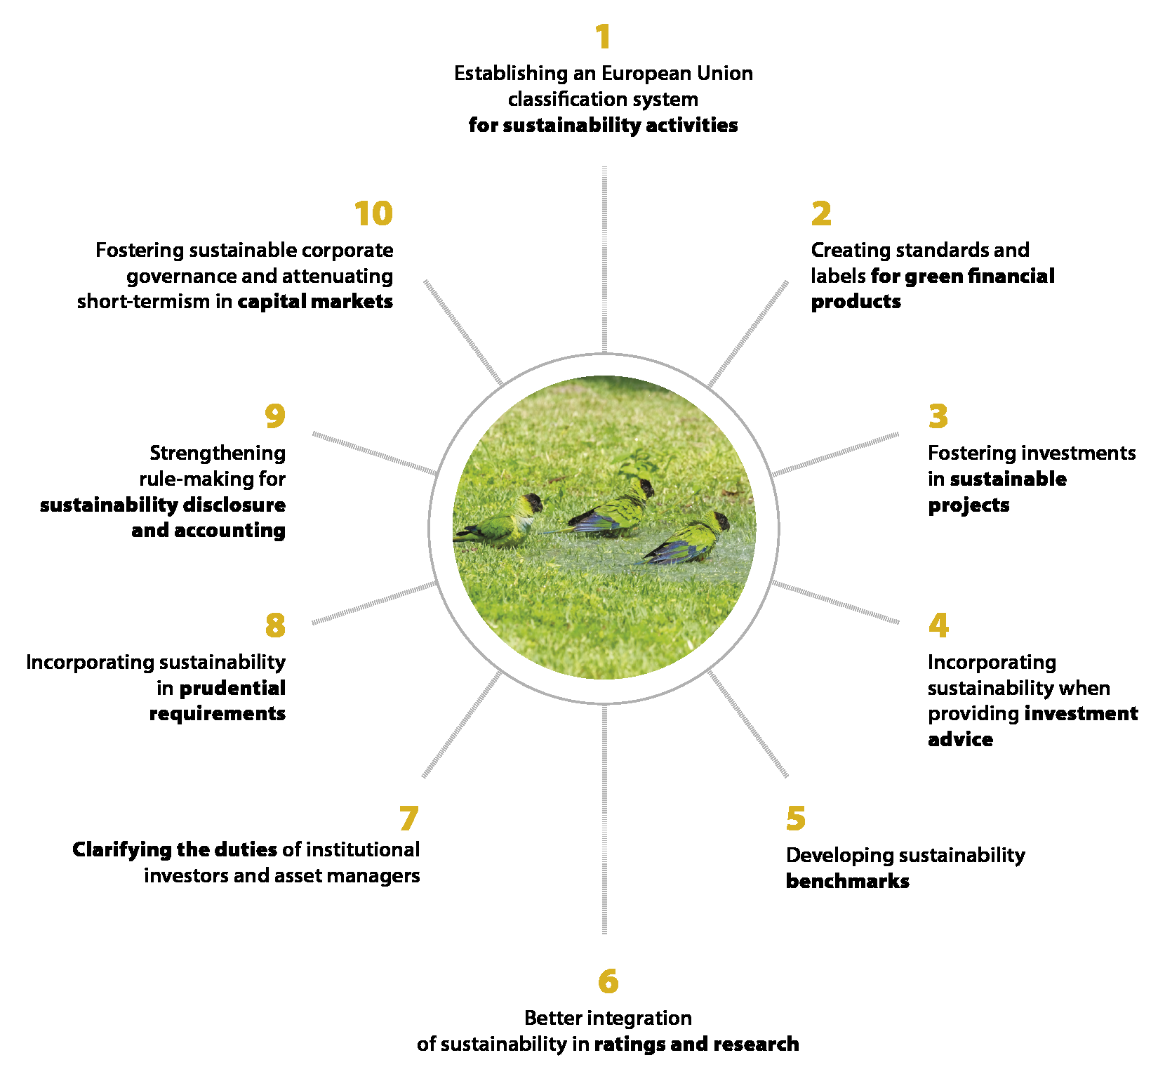
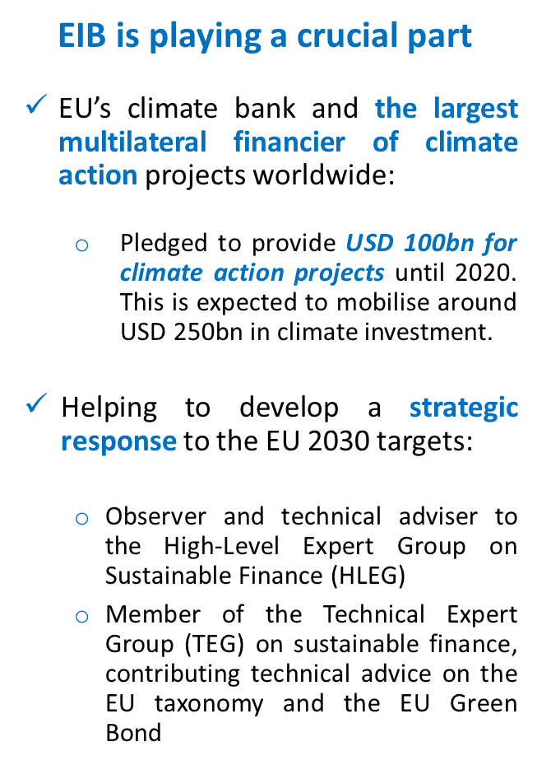
EU Action Plan on Financing Sustainable Growth

Slide 14
2018: EIB Sustainable Investment Highlights

Slide 15
EIB and Sustainable Finance
Sustainability in everything we do – this is our aim when we finance projects in innovation and skills, infrastructure, small and medium-sized enterprises, the environment, climate action and regional cohesion.
We carry out due diligence to ensure that projects meet environmental and social criteria and that they deliver the desired long-term economic benefits.
The funds raised in the capital markets through green and sustainable bonds are used for specific projects that make a substantial contribution to sustainable development.

Slide 16
Standards and Due Diligence for Sustainable Finance
Exclusion List
Environmental & Social Standards
Economic Appraisal
Projects are appraised from both a financial and a sustainability perspective
The three steps of the EIB “Sustainability Due Diligence”

Slide 17
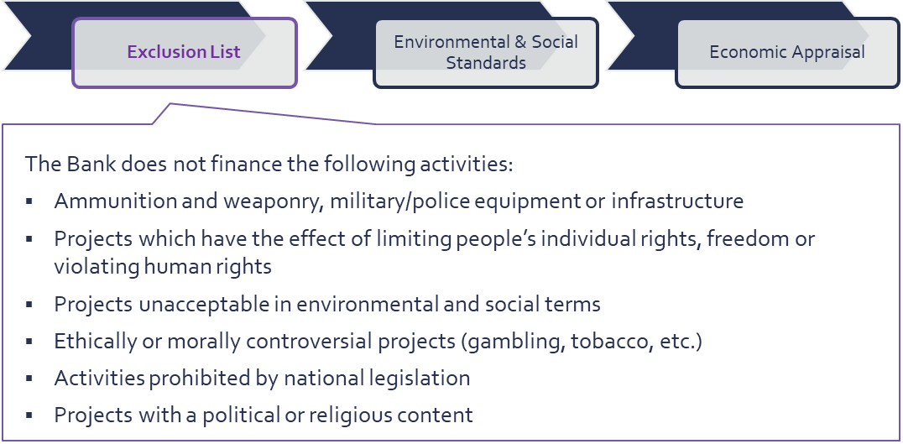
1. Activities excluded from financing

Slide 18
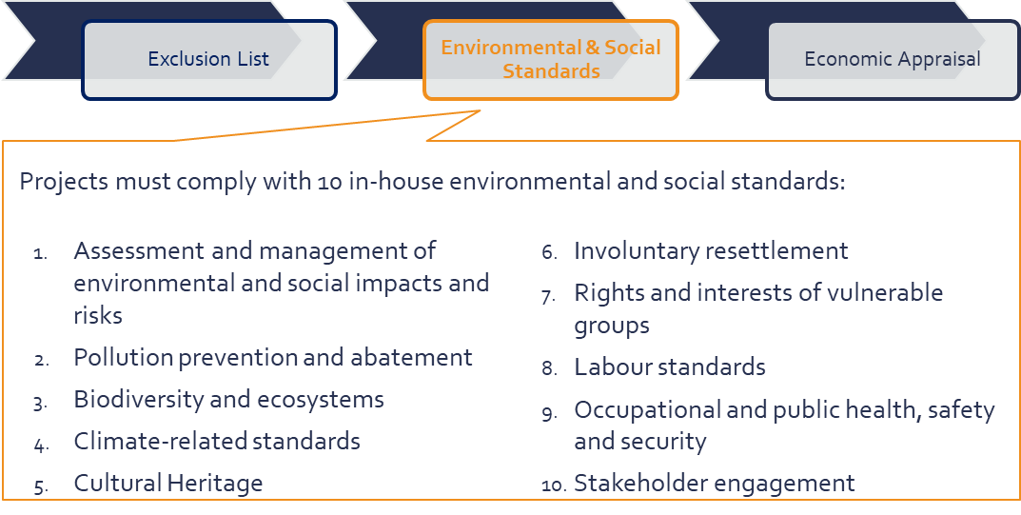
2. Projects must comply with E&S standards

Slide 19
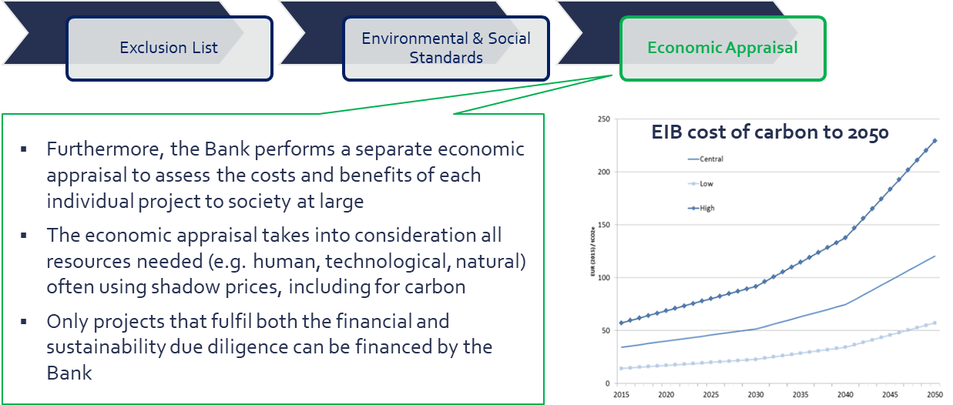
3. Assessing the impact of each project on society as a whole
Notes:
The EIB calculates the economic returns of its projects using internationally accepted methods. Beyond financial viability considerations, it also appraises the socio-economic costs and benefits to make sure that the projects the EIB finances constitute a sound contribution to society at large.
Some projects have poor financial performance, and therefore may not be financed by the private sector at reasonable terms, or at all. Private sector investors evaluate projects using standard financial appraisals that focus on private financial returns. Economic appraisal, in turn, takes a broader view to include other benefits and costs to society, accounting for all resources used by the project, whether human, technological, or natural, and gauges the value the project generates to all stakeholders, to determine whether society at large gains from the investment.
The economic viability of a project can be seen as synonymous with sustainability, cohesion and growth in many respects. A project that is economically viable generates products or services that are valued by society and that may contribute to improving productivity and growth for the economy. Any employment generated by an economically sound project would involve jobs that are sustainable over the long run. By accounting for environmental costs and benefits, economic appraisal sees that any impact on the environment is not gratuitous, while giving full credit to the benefits of environmentally efficient technologies. Finally, economic appraisal ensures that any financial support by the government or from European funds to a viable project is public money well spent.

Slide 20
Sustainable Borrowing: Raising Capital with a Purpose
Standard setter in green bonds - a pioneer and market leader in green bonds, the EIB is the largest supranational green bond issuer, contributing to the development of governance and establishment of market standards.
EIB General approach
Exposure to the EIB credit, not to underlying projects
Eligible sectors:
  Thus far: Renewable Energy and Energy Efficiency
  Future: any activity contributing substantially to climate change mitigation
Allocations only to new disbursements (no refinancing)
Transparency & Accountability
Alignment with the Green Bond Principles
Reporting on allocations, by individual project and by individual bond
Reporting on expected impact & linking bonds to projects
External Audit and Reasonable Assurance in accordance with ISAE3000

Slide 21


Pioneering Sustainable Borrowing
Climate Awareness Bonds (CAB) – EIB pioneered the launch of the first CAB in 2007. To date we have issued around EUR 24 bn in green bonds in 11 currencies
  In 2018, CAB funds were allocated to 76 projects in 29 countries across the world, out of which:
    68% of CAB proceeds were assigned to renewable energy projects
    88% of the funds supported projects within the EU
Sustainability Awareness Bond (SAB) – launched in 2018 as EUR 500m issue, the proceeds of this Bond will be allocated to EIB’s lending activities contributing to sustainability objectives in line with EU legislation e.g. sustainable use and protection of water and marine resources, transition to a circular economy, waste prevention and recycling, pollution prevention and control, protection of healthy ecosystems
Notes:
The market for Green Bonds has broken the USD 500 billion mark.
Sustainability objectives and activities are subject to revision in the context of EU legislative developments

Slide 22
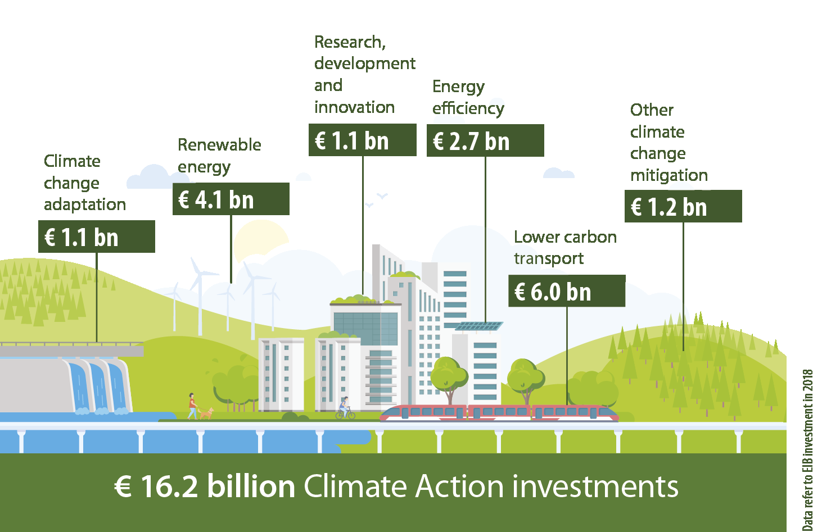
EIB – Sustainable Lending
In 2018, EIB signatures for climate action stood at EUR 16.2bn, representing 30% of the total financing across all areas of activity
  successfully meeting the target of devoting more than 25% of our financing each year to climate change mitigation and adaptation activities

Slide 23
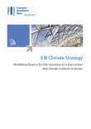
EIB supports the Paris Agreement:
From Strategy to Action by 2020
Reinforcing the impact of EIB climate financing
Building resilience to climate change
Further mainstreaming climate change considerations across EIB standards, methods and processes
Climate Strategy 2015
A
B
C
Action Plan 2017-2020
IMPLEMENT:
Action Plans (2017-2020)
1
5
7
Climate Awareness
& High Impact CA
Climate risk management for new EIB operations
Strengthen mainstreaming
2
Development of
CA pipeline
8
CC considerations in sector policies
6
Increase the portfolio
of adaptation projects
3
9
Financial innovation for climate action
Valuing Climate Risk of EIB Portfolio
4
Spur growth of Green Bond market
10
EIB Environmental Management System
Notes:
CLIMATE ACTION = TOP PRIORITY
Climate action ranks among the top objectives of the EU.
Therefore, as the EU bank, the EIB has also made climate action one of its top priorities and developed a leading position among international finance institutions in this area.
The EIB will continue to play an increasingly important role to help the EU meet its climate change targets.
CLIMATE STRATEGY
The Climate Strategy, which was built and approved in 2015, is meant to guide our medium to long-term actions within and outside the EU to reinforce EIB finance for projects which bear a positive climate impact.
As you will recall, it identified three strategic areas where, moving forward, we should focus our climate action:
Reinforcing the impact of climate financing;
Building resilience to climate change;
Further integrating – or mainstreaming - climate change considerations across all EIB standards, methods and processes.
ACTION PLANS
Over the course of 2016 and early 2017, the Climate Strategy was delineated into ten detailed Action Plans. These plans were approved in July 2017 by the Climate Strategy Implementation Steering Committee, which regroups directors from across the Bank (PJ, OPS, FI, SG and CS).
Each Action Plan is related to one of the strategic areas.
Action Plans 1 through 4 are focused on increasing the impact of our investments, testing new financial instruments and deepening the ones that we have already developed, e.g. Green Bonds.
Action Plans 5 and 6 are focused on screening all new EIB operations for climate risk and increasing the number of adaptation-related projects.
Action Plans 7 through 10 are focused on improving our mainstreaming tools (e.g., climate action targets, GHG accounting, internal carbon footprint management, pipeline planning), enhancing our sector policies to include climate considerations, valuing EIB’s exposure to climate risks and upgrading our environmental management system.
The Action Plans have recently started to be implemented, and will carry through the period until end 2019. Now that the work streams have been laid out, it is my hope that as many of you as possible will be actively engaged in the implementation of our Climate Strategy.

Slide 24
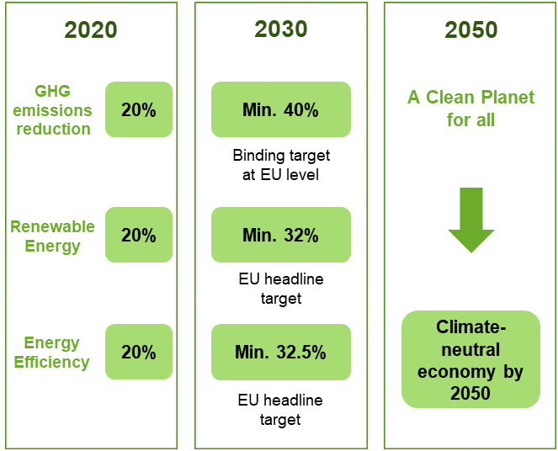
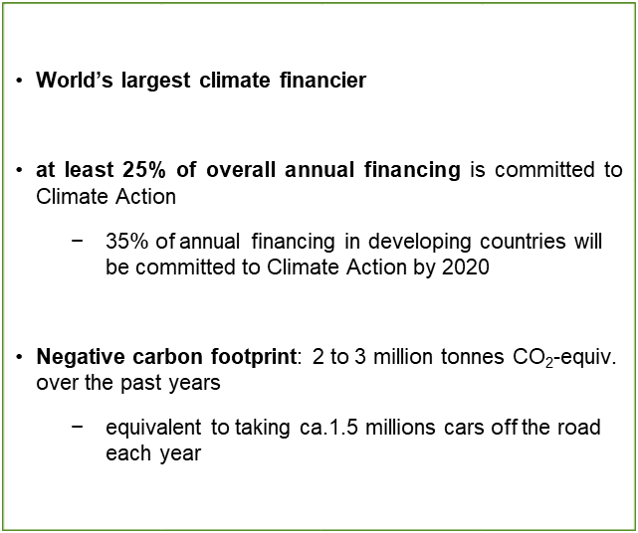
EIB: A pioneer and a valuable partner on Climate Action
  EIB Climate Action Plan
EU Climate Change Mitigation Policy Goals
Notes:
The EU is working on developing a strategic response to these targets and on reforming the financial sector to reorient capital towards more sustainable investments. The EIB is playing a crucial part in the process:

Slide 25
EIB Climate Action Lending in Western Balkans (2018)

Slide 26
Climate Action Policy cooperation with WBG/MDBs/DFIs
Climate Action in FIs Initiative with MDBs, IDFC members, private FIs: 4 workstreams (strategies, reporting , risk, cities)
Support for Green Bonds / Sustainable Finance tracking and reporting
Climate finance tracking
  MDBs’ Joint Methodologies and MDB/IDFC Common Principles (EIB leads work on Mitigation)
GHG accounting
  IFI Framework for a Harmonized Approach to Greenhouse Gas Accounting
Climate risk management
  Development of Climate Resilience Metrics with other MDBs
  Share approaches on decision-making under deep uncertainty
  Assessment of systemic climate-related risks at portfolio level (TCFD recommendations)
Best practice in adaptation and reinforced support to adaptation investments
Art. 6 of Paris Agreement: Carbon markets & monetization of climate co-benefits
➔ 2018 priorities: Sustainable finance agenda, just transition to low-C development pathways, climate risk management, resilience impact metrics, etc.
➔ EIB brings to the table its technical knowledge and its long experience as a partner of other MDBs/DFIs and other FIs in this area

Slide 27
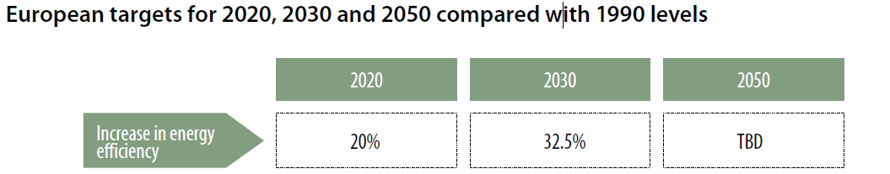
The role of the EIB in Energy Efficiency
Initiatives managed and/or initiated by EIB in the EE sector:
Within the EU
JESSICA - Joint European Support for Sustainable Investment in City Areas
ELENA - European Local Energy Assistance
PF4EE – Private Finance for Energy Efficiency (under the program for environment and climate action (“LIFE”))
EEEF - European Energy Efficiency Fund
Outside the EU
GGF – Green for Growth Fund
EPTATF – Eastern Partnership Technical Assistance Trust Fund
MPSF - Municipal Project Support Facility
ERI – Economic Resilience Initiative
NIF TF – Neighborhood Investment Facility Trust Fund

Slide 28

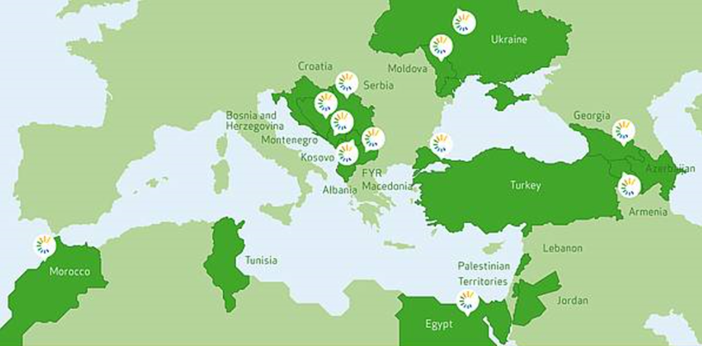
GGF - Green for Growth Fund
Created by the EIB and KfW Development Bank.
Public Private Partnership
Promote the development of EE and RE markets
Technical assistance for capacity building in partner institutions
GGF – Most recent GGF operations linked to EE
EE and CO2 emissions reduction in Bosnia and Herzegovina
EUR 10m to Ohridska Banka (North Macedonia) for RE lending
Support to Bank of Georgia Group for EE and RE lending
Promoting EE in Georgia in partnership with JSC Basisbank through a local currency loan equivalent to USD 10m

Slide 29
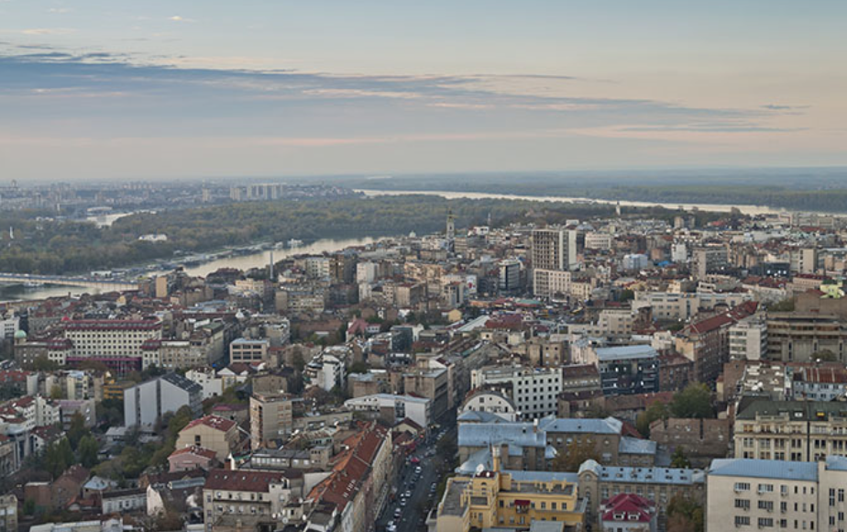
Potential participation of EIB in the First
Kosovo Energy Efficiency Fund
The Fund will provide incentives for energy saving and cleaner energy in Kosovo
Concrete step in implementing Kosovo European Reform Agenda
EU pledge of EUR 10 million with co-funding by the Government and the World Bank
EIB may participate in the Fund with investment and technical assistance

Slide 30

Global Energy Efficiency & Renewable Energy Fund
A Shares → Public Sponsors (EU, D, NOR)
B Units → Private Investors
Investment
Appointment
Investment
Board of Directors
Approval
Appointment
IC GEEREF → Investment Decision
Fund 1
Fund 2
Co-inv./ Direct
RE and EE Investee Projects
GEEREF : Energy efficiency and renewable energy
Fund size: EUR 222m (launched in 2009)
(incl. EUR 112m from public investors and EUR 112m from private investors)
Countries: Emerging and developing countries
Advisor: EIB Group (EIB also invested EUR 10m)
Investment mobilized: EUR 2.4 bn
Triple Bottom Line:
People → Social development and economic growth of local communities.
Planet → Access to sustainable energy and increased energy efficiency
Profit → Achieve robust financial returns.
Funds of funds which provides global risk capital to EE and RE projects in developing and emerging countries, constrained by high risk, lack of upfront capital and high transaction costs.
Anchor specialised private equity funds focused on RE and EE projects in emerging markets.
Harness ODA (official development aid) to catalyse private investments
Create a multiplier effect: For every €1 ODA invested, >€ 50 are deployed in final projects on the ground.
GEEREF is one of the first instruments that has demonstrated that it is possible to mobilise private financing by using public funds as risk capital in a financing structure.
GEEREF NeXt will be the successor vehicle, aiming to replicate GEEREF at scale (target fund size of USD 750m), with the Green Climate Fund (GCF) as the anchor investor.
Notes:
Policy test upfront and project-driven (i.e. primary focus on the underlying assets in terms of fit with EIB objectives and economic benefit)
Can invest time to work with a fund manager from concept stage
Can go into segments not quite mainstream yet
(e.g. bio-diversity, land decontamination, land use/carbon)
Can support start-up teams and new concepts
Can play different management roles alongside investment

Slide 31
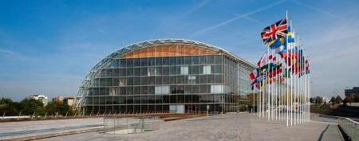
Thank you

