Slide 1
The role and responsibilities of the European banking sector for achieving a sustainable future
Albanian Association of Banks 3rd Conference
Banks for Sustainable Development
14 May 2019 – Tirana, Albania
Sébastien de Brouwer
Chief Policy Officer, EBF
1

Slide 2
Who we are?
EBF as a catalyzer: Creating partnerships to accelerate and improve sustainability of the banking sector and the economy as a whole
EBF amongst first endorsers of Principles for Responsible Banking
Wim Mijs, CEO, EBF
“Sustainability should be an integral part of everyday culture, processes and decision-making. Supporting a sustainable future is about achieving long-term business benefits and prosperity. Our goal is a financial system that embraces financial benefits as well as societal and environmental benefits. Once that’s achieved all finance will be sustainable. We will no longer need to speak about ‘sustainable finance’ as such.”

Slide 3
EBF members 32 national associations
28 EU member states 4 EFTA countries
14 associate countries
Including Albania

Slide 4
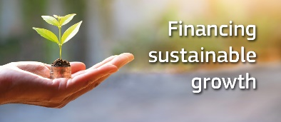
European Commission Action Plan on Financing Sustainable Growth
Adopted in March 2018 – 10 Actions
3 main objectives:
Reorient capital flows towards sustainable investment, in order to achieve sustainable and inclusive growth
Manage financial risks stemming from climate change, environmental degradation and social issues
Foster transparency and long-termism in financial and economic activity
Very Much in line with the SDGs / UN 2030 agenda – COMPLEMENTARY
EBF committed to support the Commission’s actions
EBF partnering to address the global financial challenges related to achieving the SDGs (closely working with UNEP FI).
4
Notes:
4

Slide 5
EBF organization on sustainable finance
Steering Committee for Financing Growth
Joint TF SF/Fintech
Joint TF SF/Banking Supervison Committee
Sustainable Finance WG
Subgroup 1:
EU Green Taxonomy
Subgroup 2:
EU Green Bonds
Subgroup 3:
Disclosures, Indices & Metrics
Subgroup 4:
Incentives/
desincentives
Subgroup 5:
SDGs
5
Notes:
5

Slide 6
Promoting sustainable finance, a strategic priority for EBF
The four “E”s as a guiding principle
Enabling:
Smart regulatory framework that enables banks to support their clients in reducing negative and increasing positive impacts.
Encouraging:
Both the legislative and non-legislative framework have to be reviewed to encourage and reward the shift towards sustainable economy.
Engaging:
Commitment to raise awareness and scale up competences to improve sustainability of bank and market-based financing: PRB & incorporation of ESG risks in risk management
Educating:
Educating on sustainability for both empowering consumers and finance professionals to better understand, measure, integrate analyse and price sustainability risks.
6
Notes:
6

Slide 7
Sustainable Finance
Incentives
SDGs / PRB
EBA , ECB , NGFS
Engagement in regulatory initiatives
TEG
Taxonomy
Disclosures
Proactive work to promote sustainable finance
Benchmarks
Good practices exchange and capacity building
7
Notes:
7

Slide 8
EBF working lines
Legislative proposals
Taxonomy
Disclosures
Benchmarks
Engagement with the TEG
Corporate reporting
Fitness check/ NFRD update
Update of NFRD Guidelines
Other regulatory initiatives
Mandate given to EBA on CRR & CRD
EBA report on short term pressure
EBA and ECB work on climate/ESG risks
Proactive work
Principles for Responsible Banking: endorsement & consultation
EBF report on SDGs
EBF Guidelines taxonomy & loans
Incentives
8
Notes:
8

Slide 9
What’s next
Active engagement with EBA
Continuing engagement with EU legislators and TEG
Report on incentives to promote sustainable finance through banking (July)
EBF guidelines to apply EU taxonomy to lending portfolios (October)
Signature of the Principles for Responsible Banking (September)
Banking Summit (2nd/3rd October) , including sessions on Sustainable Finance
EBF report on SDGs (year end 2019)
9
Notes:
9

Slide 10
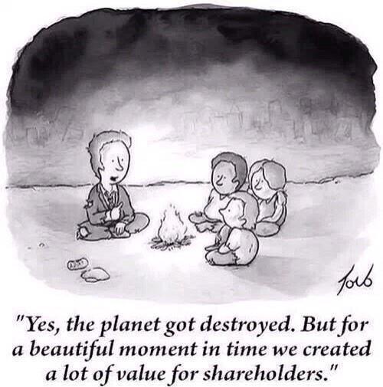
Responsible banking: A game changer
Transformation of the banking sector, banks’ strategies and business models, risk management, product developments, customer relationships, communication…
Opportunity for banks to connect societal and financial goals

Slide 11
Setting ambitions and defining long term strategies
Individual actions
Steering portfolios towards meeting the Paris agreement and SDGs
Pledging significant amounts for investments in sustainable finance
Navigating away from certain investments
Supporting innovative start-ups
Collective actions
Banks amongst the first movers on the TCFD Disclosures
16 leading banks (8 European) working with UNEP FI on climate scenarios
Coalition of banks working on Climate Alignment Portfolio methodologies
Principles for Responsible Banking
11
Notes:
Paris Agreement December 2015 -keeping a global temperature below 2 degrees Celsius above pre-industrial levels and to pursue efforts to limit the temperature increase even further to 1.5 degrees. - strengthen the ability of countries to deal with the impacts of climate change. To reach these goals, appropriate financial flows, a new technology framework and an enhanced capacity building framework have to be put in place, thus supporting action by developing countries and the most vulnerable countries, in line with their own national objectives. The Agreement also provides for enhanced transparency of action and support through a more robust transparency framework.
Katowice (December 2018) agreed on rules to implement the Paris Agreement.
SDGs GOAL 1: No Poverty, GOAL 2: Zero Hunger; GOAL 3: Good Health and Well-being; GOAL 4: Quality Education; GOAL 5: Gender Equality; GOAL 6: Clean Water and Sanitation
GOAL 7: Affordable and Clean Energy; GOAL 8: Decent Work and Economic Growth; GOAL 9: Industry, Innovation and Infrastructure; GOAL 10: Reduced Inequality; GOAL 11: Sustainable Cities and Communities; GOAL 12: Responsible Consumption and Production; GOAL 13: Climate Action; GOAL 14: Life Below Water; GOAL 15: Life on Land; GOAL 16: Peace and Justice Strong Institutions; GOAL 17: Partnerships to achieve the Goal
Task Force for Climate Related Financial Disclosures (TCFD): Banks were amongst the first movers on the TCFD Disclosures, with 16 leading banks working with UNEP FI to develop methodology to increase banks’ understanding of how climate change and climate action could impact their business. 8 European banks : BBVA, Rabobank, Sanstander, Societe Generale, Barclays, Standard Chartered, UBS, BNP. The methodology published in April 2018 provides the first publicly available guidance designed specifically for banks to carry out forward-looking, climate-related risk and opportunity assessments as envisioned by the TCFD. Phase II of the project -case case studies on participating banks’ own portfolios, improved methodologies and new or improved data sources.
Climate Alignement Portfolio methodologies – methodology to measure whether banks’ clients portfolios are aligned with the objectives of Paris agreement.
11

Slide 12
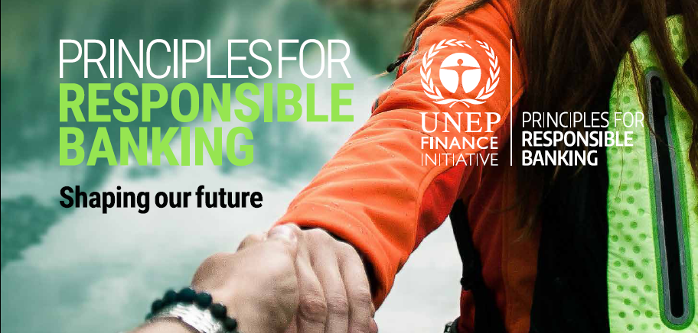
Principles for Responsible Banking
First comprehensive global Frameworks for the sustainable banking future
Accelerate banking industry contribution to achieving SDGs and Paris Agreement goals
Framework with “teeth”: accountability through public reporting and review
Complementary to the EU Action Plan and existing national and international frameworks
12
Notes:
12

Slide 13
The journey of the Principles
UNEP FI initiative
Developed by global coalition of banks committed to transform banking industry
9 European banks out of 28
Advised by civil society organizations
Launched in November 2018
Public consultation until end of May 2019
Signature of the principles 22 September 2019
50+ signatories to date
13
Notes:
Endorsers: Spanish Banking Assocaition, Febelfin, ABBL, Dutch Banking Association
Banks that joined later: ABN Amro, Danske Bank, KBC, Standard Chartered, Jyske Bank… https://www.unepfi.org/banking/bankingprinciples/endorsing/
Interesting: Greek national Bank as endorser
13

Slide 14
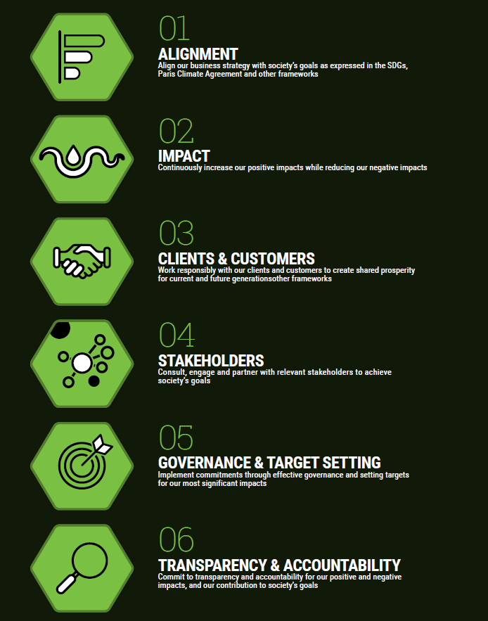
6 Principles
Key features
Identification of the impact
Public target setting
Key performance indicators
Risk assessment
Transparency
Trust and customer engagement
14
Notes:
14

Slide 15
Key requirements
Identify and assess where bank’s portfolio and service offerings generate, or could generate, the most significant positive and negative environmental, social and economic impacts.
Systematically identify where banks can support their clients in reducing negative and increasing positive impacts by adopting new technologies, business models and practices.
Set and publish targets that align banks’ business with the objectives and targets of SDGs, the Paris Climate Agreement, and other relevant national, regional or international frameworks.
Define key performance indicators to address, reduce and mitigate significant negative impacts and to scale up positive impacts.
Undertake forward-looking assessments of sustainability-related risks and opportunities.
Manage and mitigate significant risks.
15
Notes:
15

Slide 16
Implementation challenges
The information needed to meet the standard required is not readily available
Challenges to integrate sustainability risks in the overall risk management
Challenges to assess the impact from retail and SMEs portfolios due to lack of information
Challenges to assess social impacts given lack of methodologies and data
16
Notes:
16

Slide 17
How do the Principles fit the EBF objectives?
Strengthening legitimacy of the European banking industry
Rebuilding trust with clients, investors, policy makers and regulators
Positioning the banking industry as an integral part of the society and economy of the future and strengthening its positive impact
Create a standard/benchmark for responsible banking
17
Notes:
17

Slide 18
Thank you for your attention!
Sébastien de Brouwer
Chief Policy Officer, EBF

