Slide 1
Digital Banking Opportunities and Challenges

Slide 2
Agenda
Banks speak with one voice
Banks speak with one voice
A New Channel Mix
Digital Banking Evolution in the Banking Sector
Bankat flasin me një zë
Bankat flasin me një zë
Takeaways
A More Demanding Customer

Slide 3
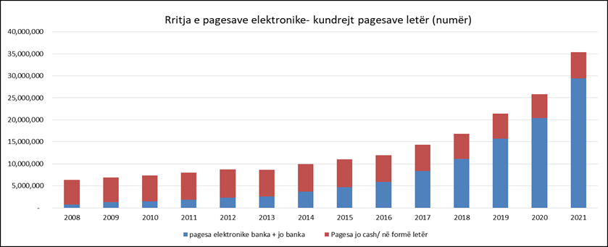
Electronic Payments a Game Changer
Digital Payments vs. paper based
Banks speak with one voice
Bankat flasin me një zë
Evolving Market
Banks invested ~ 70Mio Euro on digitalization process (ATM, POS, Ecommerce, Online Banking platforms, Security, Auditing);
All Banking system offers all payments alternatives from cards to all alternative channels & tools;
Domestic/International Transfers + Utilities + all payments through banking system, especially through online banking platforms, investing in the most innovative and highly secured banking platforms;
Banking System Challenges
Activate the customer base through expanded acceptance including Government services on market level;
Cash and informality reductions;
Financial Inclusion
Notes:
Huge progress on digitalisations especially last 3 years. Pandemic boosted the business line.
Increased customer penetration on digital banking platforms ` 700,000+ accounts with OB access. Doubled during last 3 years.
Banking focus and prioritisation on this direction;
Investments, infrastructure, staff training, security as per the international standards,
Still we have some challenges and obstacles to overcome: Cash informality, Govt institutions..

Slide 4
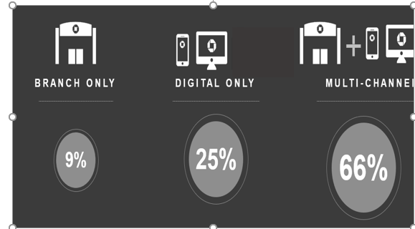
From Physical to Phygital
The inevitable road (if they are to survive) for the Albanian banks is to strike the proper balance between physical and digital channels.
Developed market data shows that over 60% of customers prefer a combination of both channels.
Our banks should continue the path for stepping up investments in digital.
At the same time, they should revamp their most prized asset, the branches.
Equally as important is that the regulatory bodies update the legislation to get us in line with other markets, and that central institutions take measures to modernize their technology in order to keep pace with the banks.
Banks speak with one voice
-19.4%
Bankat flasin me një zë
Notes:
First objective – Converting Physical to Phygital
Branches shrinking
More services online

Slide 5
A New Channel Mix
Until recently, our banking sector has been strictly reliant on the physical channel for acquisition and lending.
As banks are increasing their investment in the digital front, the channel mix is shifting ever more increasingly towards a healthier physical/digital balance.
Further progress will require more legislation clarity on digital acquisition (Anti Money Laundering Authority needs to formally and clearly remove restrictions).
Banks speak with one voice
Bankat flasin me një zë

Slide 6
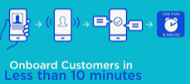
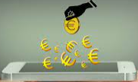
A More Demanding Customer
Banks speak with one voice
Customer Focus
Digital Onboarding
Digital Lending
A fully Digital Customer journey for
Banking Services
……..Customer Onboarding to digital payments…
Cards, POS, E-commerce, Online Banking
Bankat flasin me një zë
Digital Payment Ecosystem
Digital Signature
Remote Assistance /Chatbot

Slide 7
Takeaways
Pre-requisites to strengthen digitization of the banking sector
Banks speak with one voice
Legislation
Needs to accommodate the banks in their efforts to onboard and lend digitally (AML regulation is still a show-stopper).
Bankat flasin me një zë
Cooperation (Public Sector- Banking Sector)
Central institutions need to upgrade technology just like banks are doing in order to allow seamless and real-time information exchange for the purpose of providing payment and lending services to the customers (start on step by step enhancements);
E-Albania access to banking system receive customer info with customer consent for keeping customers out of the banks branches, providing “one stop shop service”;
AKSH / E-Albania payments services offered by Banks (E-banking and E-commerce) – ongoing project based on Task Force;
Government Incentives to drive digitalization
Mandates for the businesses to pay through online channels instead of cash - (Max value allowed by law enforcement for payments with cash for individuals and business;
Incentives (VAT reimbursement on small % if payment done through POS-s vs Cash);

Slide 8
Banks speak with one voice!

