Slide 1
Alternative Payments

Slide 2
About Symmetric
Established in 2010 in Albania focused in Electronic Payments.
In 2013 co-funded PayLink (card payment processor) then drove the implementation and certifications with Mastercard.
In 2019 Symmetric started Openpay Fintech project to facilitate Retail Instant Payments.
Payment Institution License based on the new law – in process.
Office in Tirana
Office in Brussels (in progress)

Slide 3
The problem
“Banks”
High cost to acquire and maintain card (License, POS network , eCommerce).
Strict rules impacted by the schemes, certification cost delays the time to market for every new product.
“Merchant”
High cost to accept card payments (especially in eCommerce).
Mico-payment aren’t accepted everywhere.
“Buyers”
Restricted acceptance (only 14,000 POSs ) – consumers have always to withdraw CASH to be safe that they can pay everywhere.

Slide 4
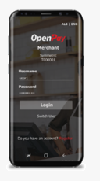
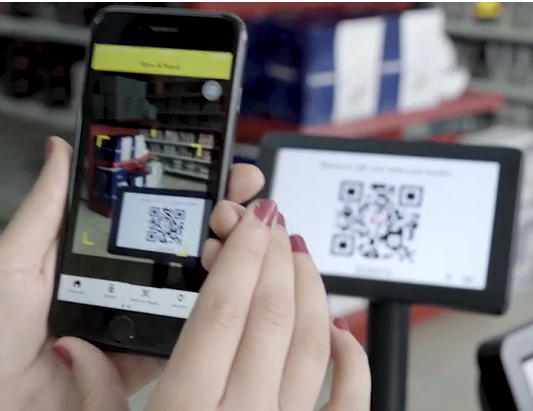
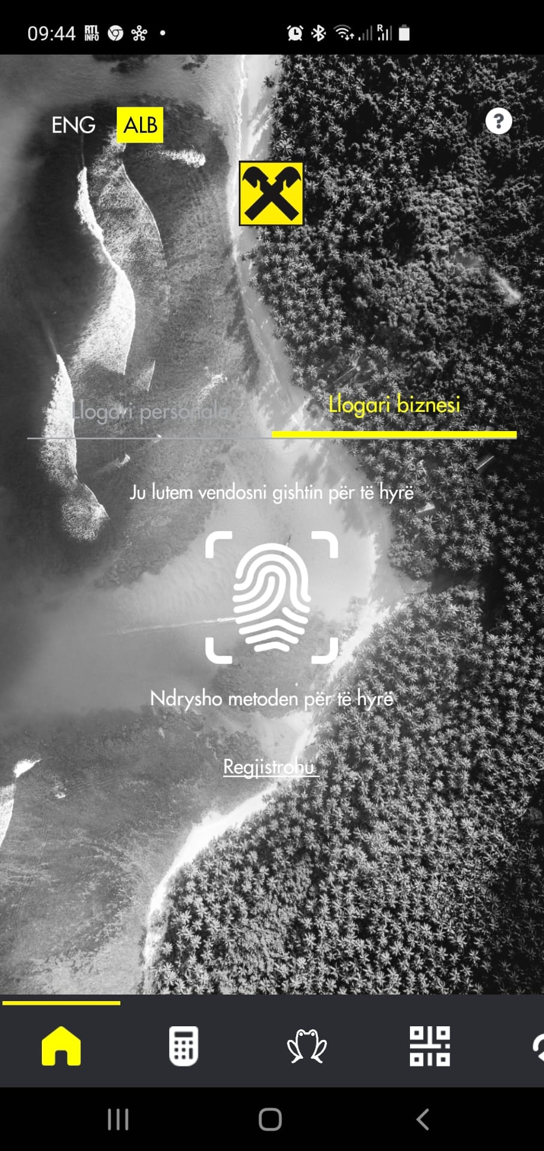
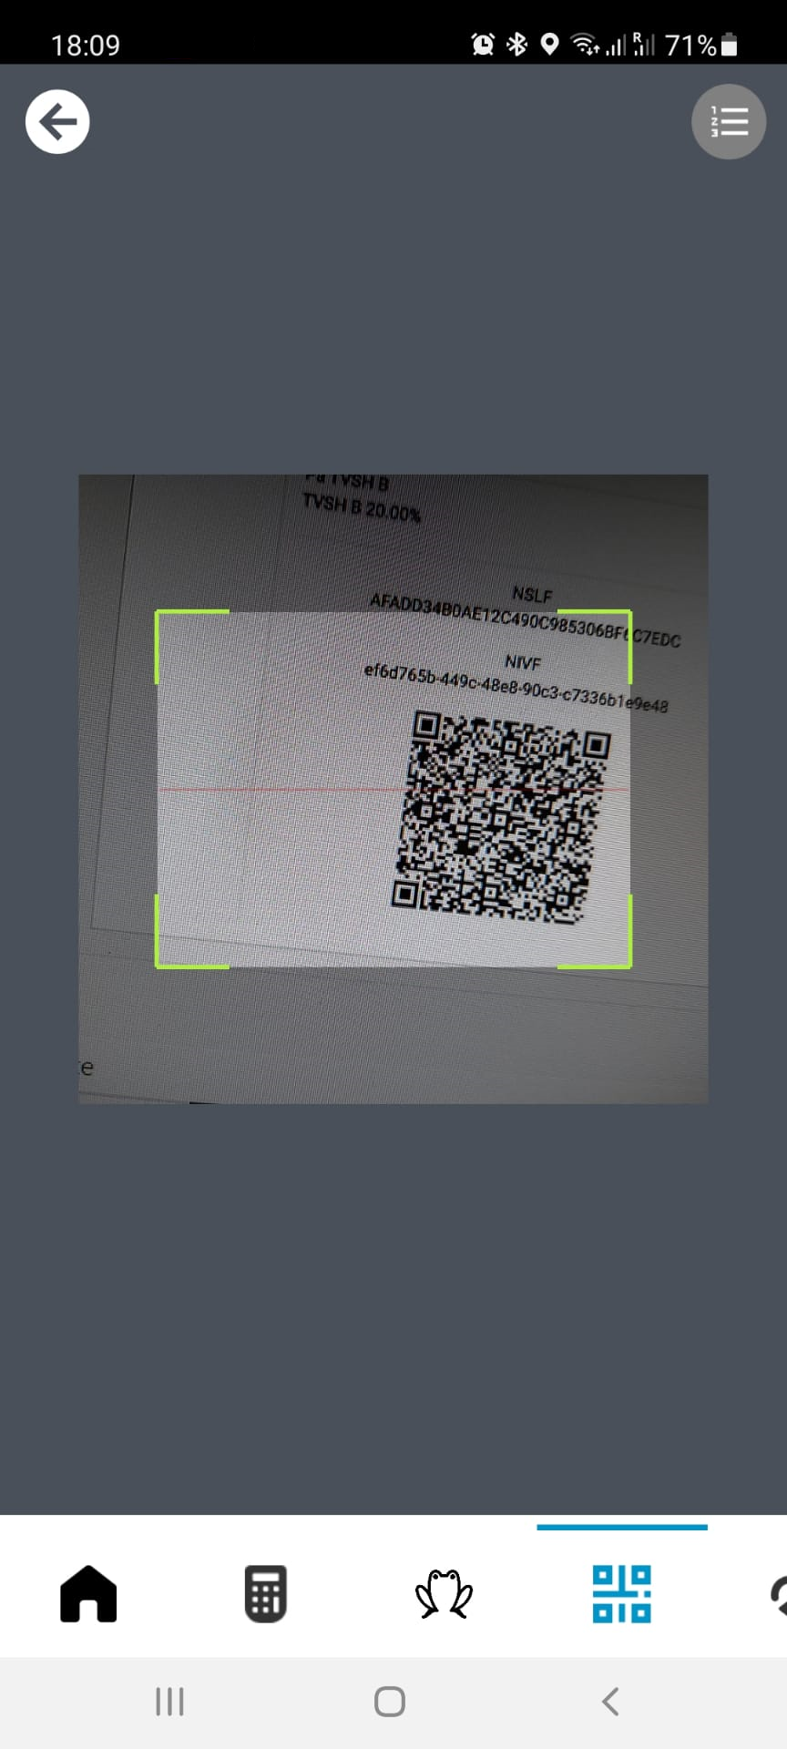
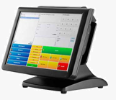
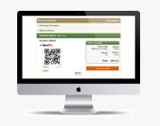
OpenPay-The payment gateway between the banks and merchants
Bank 1
Merchant Mobile POS
API
Bank of Albania
Clearing/settlement
API
API
POS (ECR)
Existing ECR/e-Commerce
infrastructure
Existing Mobile banking
app (integrated as plugin)
API
API
e-Commerce
Bank 2

Slide 5
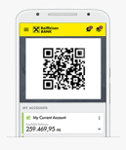
Cost Comparison Card payment VS Openpay
Acquiring Fee -cost
Acquiring Processor
Profit sharing Fee
Scheme Fee
Card Authorization Fee- cost
Issuer Processor
Completing the payments
consumers would need just an app.
Terminal-cost
3DS-cost

Slide 6
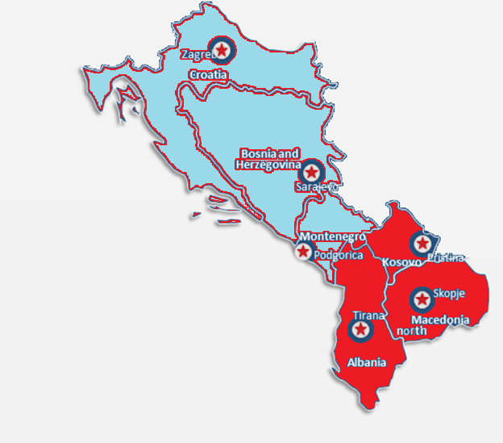
Market- Current Running Projects
The strategy to enter in international markets is through partners:
-Already established partnership in N.Macedonia, and Kosovo.
-Right now we are in discussion for a partnership in Bosnia and Montenegro and Croatia.
Started the project with one bank
Integrated with 2700 POS and the largest ecommerce’s
Albania
Live
In progress 2 other banks
Started the project with one bank
Integrated with 700 POS and the largest ecommerce
Kosovo
In progress 1 other bank
In negotiation with one bank
Integrating with 500 Point of Sales
North Macedonia
In progress

Slide 7
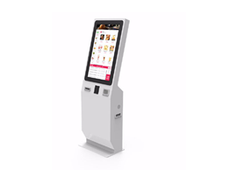
Applied Industries
eCommerce
Supermarkets
Retail shops
Hotels
Professional Service
Bar/restaurants
Taxis
Self Services for both Public and Private Sector

Slide 8
Merchants

Slide 9
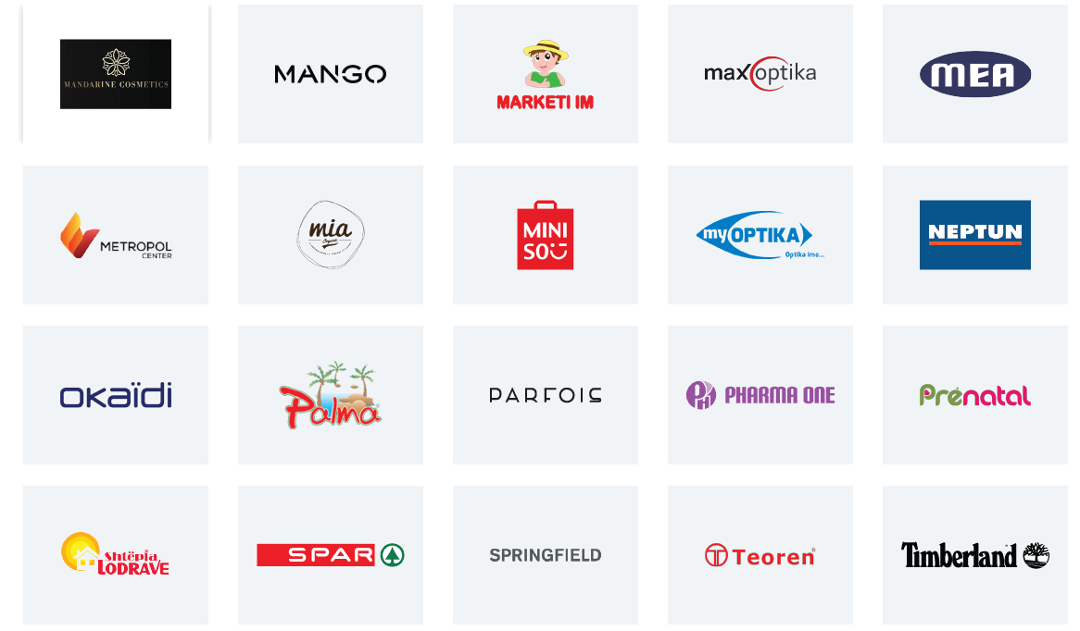
Merchants

Slide 10
Business Case: Integrated Physical Shops
Business case for supermarkets and large retailers.
We have integrated the largest supermarkets 2,700 integrated point of sales in Albania.
Big Market , Ehw.GMBH, Green Market, KMY
WELL, Eco Market, Megatek,Ana Market
Alb Market,Plaza Italia,Macron Store
Mon Cheri,Smeg Albania,Smart ELECTRONIC Ring
Buyer Scans the code Using Mobile Banking app and confirms the payment with the fingerprint.
Payment is completed and money are instantly transferred from Buyer’s account to Seller’s account.

Slide 12
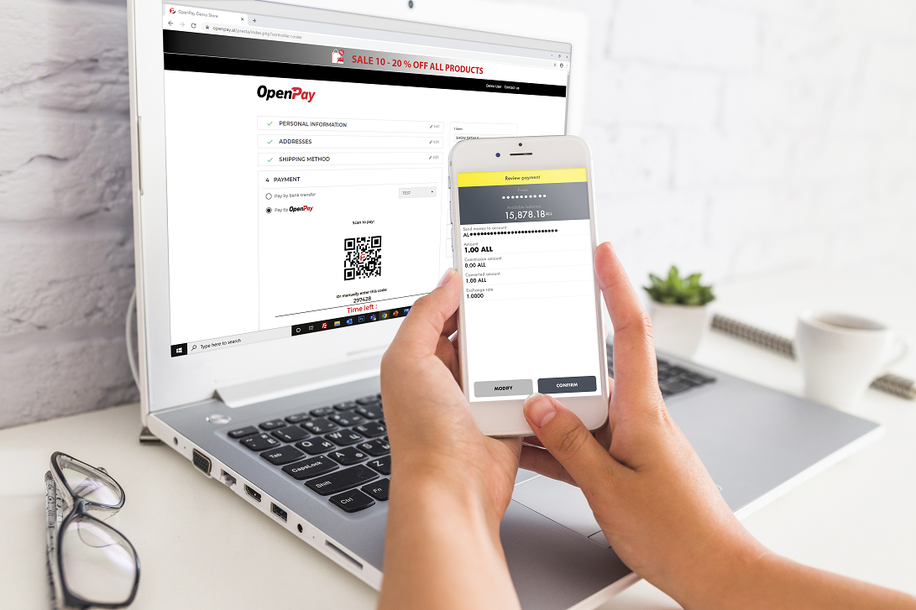
Business Case:eCommerce
Business case for online shops.
We have integrated the largest eCommerces’ in Albania and some others are in process (Aladini, shpresa.al ,Avatars).
After the check out Buyer Scans the code Using Mobile Banking app and confirms the payment with the fingerprint.
Payment is completed and money are instantly transferred from Buyer’s account to Seller’s account.

Slide 13
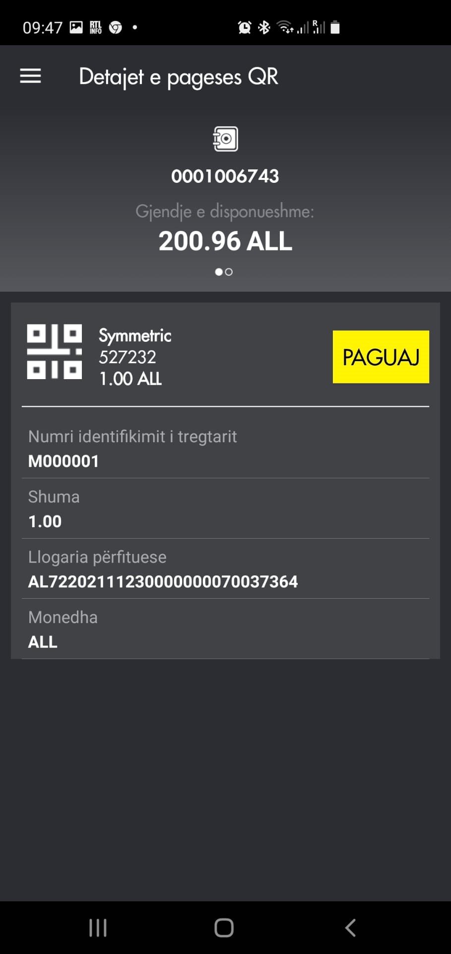
Business Case:mCommerce (no QR code is needed)
Product is selected
Check out with Openpay
mBanking is opened automatically
with the prefilled amount .

Slide 15
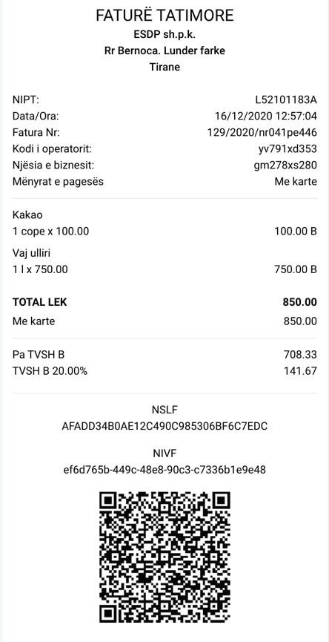
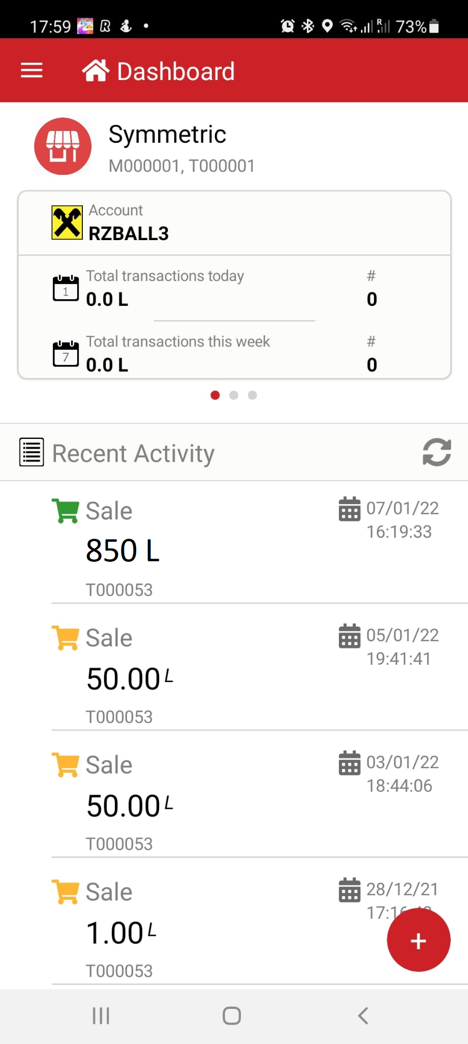
Business Case:Fiscal Invoice
The fiscal invoice is printed
(today more than 200,000
Merchants can print fiscal invoice)
Merchant (cashier) confirm the payment in his Openpay Merchant app (or in his computer)
Banking Client scan the QR code and complete the payment.

Slide 17
Business Case: Public Sector projects
Openpay can be integrated with a various Public Sector projects such as Parking,
Public transport and eAlbania.
The client scans the QR code using Mobile Banking
application and confirm the payment using the
method offered from the bank. Openpay facilitate the payment between client account and AKSHI’s or
public’s institution account
After the client choses the desired service a QR
code is generated wit the payment details

Slide 18
OpenPay facilitates the payment between the banks an public sectors with a very low cost.
Bank 1
Banks can use Openpay gateway to connect to AKSHI’s web service in a secure way.
API
API
Bank 2
Mobile banking

Slide 19
Benefits
Benefit for AKSHI: Integrate with one gateway and have access to all the banks.
The solution provides reasonable low cost which significantly lower with the current market reality of card payments and (no card fees, no card scheme fees).
All the banks in Albania can offer payment using this method and this will not require any additional license.
All the banks can offer this service to their client but also the inter-banking payments are possible.
The confirmation of the payment is done in real time so the money will be transferred in real time (card payment will require 3-5 days confirmation).
Openpay allows the banks to exchange with AKSHI via the web service a large number of data related.

Slide 20
How to join Openpay?
Every bank that has is offering mobile banking app can connect to to Openpay.
Two changes are required to connect to Openpay:
Implement 2 APIs (webservice)
Core Banking system
Implement QR code scanning on Mobile Banking

Slide 21
How QR payment can be implemented in the national level?

Slide 22
Interbanking Payments
For each inter-banking payment (when the merchant and consumer have account in different banks):
Openpay blocks the authorized amount.
Calculate the reconciliations report including the net amount to be paid between banks.
Settlement could be completed through BoA systems (AIPS/AECH ) once per day.
Core Banking system
AIPS/AECH
Core Banking system

Slide 23
Benefits for the Economy
Inline with the Bank Of Albania strategy for lowering the electronic payments costs and micropayments.
It bypasses the traditional Card Payment Infrastructure and offers low cost alternative infrastructure for banks and merchants.
It creates a new payment ecosystem for and will accelerate the development of eCommerce/mCommerce payments.
System is coming with a very low cost comparing to other method and all the banks can participate.
Project can be considered and the future low cost National Payment Switch for the banks.

Slide 24
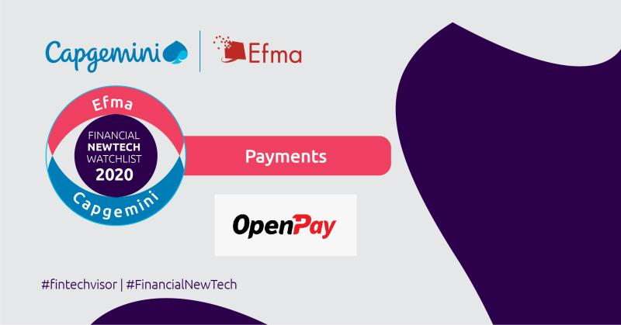
Achievements
2018-Won first Place in local elevator Lab
organized by Raiffeisen Bank International.
2020- Won first place in the field of eCommerce
Payment in the scaling category.
2020- Challenge winners. Following the Star
Venture scaling Program Organized by EBRD.
2020- Nominated as the best 10 startups
in Payments category.

Slide 25
Contacts
Web site : www.openpay.al Dritan Mollanji
Founder /CEO
Address: Rr. Ismail Qemali, P. 7/1, Shk. 2, K.3, Nr. 10, Tirane, Albania
Mob.: + 355 6760 00192
dritan.mollanji@symmetric.al | www.symmetric.al

